Slide 1
Meeting of the Local Community Development Committee (LCDC)
26th March 2025.
Quorum:
Correspondence:
Minutes of previous meeting dated 26.02.25
Proposed by:
Seconded by:

Slide 2
Matters arising
Update by Cathriona Mac Carthy
In the context of funding under SICAP 2024
Question was raised about the 19th Infantry Battalion FCA and the structure of same.
This is a coming together of like minded people, FCA and P.D.F. members of the former 19 Infantry Battalion. The aim of the Association is for members of the former Battalion to keep in contact with each other and to celebrate and remember past members of the Battalion.
The quorum to be present before business can be transacted is 50% of the membership of the Committee, rounded to the nearest whole number, plus one. This quorum shall be maintained for the duration of the meeting. Where members must abstain from decisions, due to conflict of interest for example, this does not affect the quorum.

Slide 3
LCDC Membership update by Cathriona MacCarthy
Business Representative – Welcome to John Bergin, All Star Shredding. Ratified at Council meeting of 24.03.25
Social Inclusion Representative – Recruitment for the position has commenced. Public notice re the vacancy has gone out. Closing date for receipt of nomination is Friday 4th April.

Slide 4
SICAP Presentation by: Donnacha McSorley

Slide 5
SICAP update by Cathriona MacCarthy
SICAP – For noting
Roscommon Leader Partnership have opened up the Community Organisation grants under SICAP. It has been sent to all the groups registered on IRIS and will be on their website shortly. Projects for equipment up to €750.00 will be considered.

Slide 6
Health and Wellbeing Sub-Committee–Update by Eamon Hannan
Submission of 2024 Report to Pobal with a total HIF spend of €103,930.15 on Roscommon based initiatives. Approval awaited and release of 2025 funds.
Sub committee approved external evaluation of 3 programmes funded by HIF in Roscommon in 2025, this will compliment evaluation of Menowell Programme and Roscommon Sports Partnership programmes planned for this year. As we come to the end of HI Round 4 at the end of 2025 it will give us data on which we can determine success achieved and future needs should the framework continue beyond 2025.
‘Taking Stock’ Farmer Wellbeing initiative now in the final week of Phase 1. Next stage will involve wellbeing checks at local marts and information sharing through Teagasc Advisors, private farm consultants and local co-ops.
Healthy Roscommon Community Wellbeing Plan 2025 – 2029 has gone for printing and will be launched in May.

Slide 7
Funding Updates by Cathriona MacCarthy
Local Enhancement Programme 2025 Support Community Groups, particularly in disadvantaged areas. This years programme is designed to provide both capital and operational funding support. Any “not for profit”, community or voluntary group could apply. Commercial organisations and individuals are not eligible.

Slide 8
Recommendation from the Evaluation Committee.
Meeting held on 12/03/2025
Operating costs – Operating costs to be allocated to all groups requesting same. Allocation to be capped at €500 in order to support all valid applicants.
89 groups applied for Operating funding, each group got 51% of what was applied for totalling €21,976.
          Proposed by:
          Seconded by:

Slide 9
Recommendation from the Evaluation Committee.
Meeting held on 12/03/2025
Capital Projects
113 Applicants for funding.
Permission sought from the department to extend the small grant application amount from €1000 to €2000 due to lack of applicants €1000 and under. Granted by the department.
Each application was evaluated under the below agreed headings, derived from the guidance document on the scheme from the department.
  Pobal Deprivation Index
  Environment, Climate
  Accessibility
  Ability to Deliver

Slide 10
Recommendation from the Evaluation Committee.
Meeting held on 12/03/2025
It was agreed by the committee to make a recommendation of support the top 39 projects.
34 capital projects – 100% funded
*5 capital projects – 85% funded
Small Scale Capital Projects
13 of the 39 projects recommended for LCDC approval were classified as small scale projects (<€2000) totalling €17,209.88.
As this was lower than that recommended by the department, 30% of total Capital Allocation, €39,000, in the scheme guidelines, permission to progress was sought and granted by the department.
          Proposed by:
          Seconded by:

Slide 11
Recommendation from the Evaluation Committee.
Meeting held on 12/03/2025
Medium Scale Projects
26 of the 39 projects recommended for LCDC approval were classified as medium scale projects (>€2000) totalling €112,499.74
5 capital projects – 85% funded as they scoured the same during the evaluation phase.
          Proposed by:
          Seconded by:

Slide 12
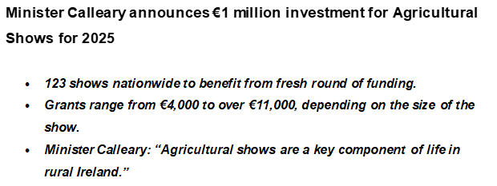
Funding Updates by Cathriona MacCarthy
FOR NOTING
5 Agricultural shows funded in Roscommon totaling €40,955
Boyle Summer Show
Castlerea Agricultural Show
Elphin Agricultural Show
Roscommon Agricultural Show
Strokestown Show

Slide 13
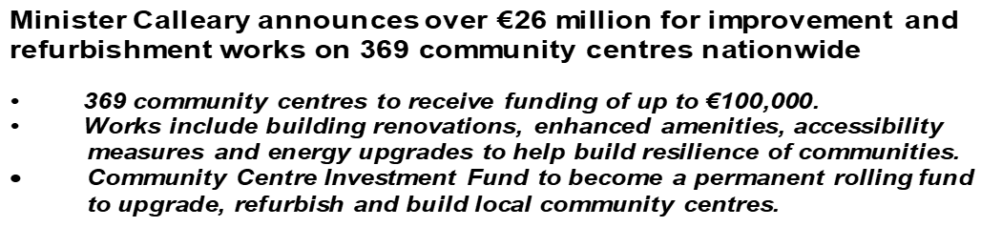
Funding Updates
By Cathriona Mac Carthy
Roscommon Community Centres receiving a total of €691,236
Group | Community Centre
Athleague Community Centre CLG | Athleague Community Centre
Ballintubber Development Association Ltd | Old School House
Ballyfarnon Community Enterprise Group CLG | Ballyfarnon Community Centre
St. Kevin’s GAA Club, Castlerea | St. Kevins’s Community Centre
Drum Community Centre | Drum Community Centre
Kilmurry Hall Committee | Kilmurry Community Hall
Roscommon Gaels GAA Club | Dr. Hyde Community Centre
St. Joseph’s Hall, Boyle | St. Joseph’s Community Hall
Moore Community Council | Moore Community Centre
Ballinagare Health and Leisure Centre CLG | Ballinagare Community Centre

Slide 14
Funding Updates by Cathriona MacCarthy

Slide 15
Any Other Business
Public Consultation on the Future of Rural Ireland – email sent by Bridie 21.03.25. Response required by Wednesday 2nd April
Invitation: LCDC Internal Focus Group – Tullamore - 31st March 10am to 12 noon
  The Department have advised that they would like 2-3 people from each LCDC to attend this Focus Group. To that end, we would be looking to have 1representative from the Public sector and 1 representative from the Private sector. Cathriona as Chief Officer, will also be in attendance.
Minister Dara Calleary Launches 2025 SuperValu TidyTowns Competition celebrating 67 years of environmental and community effort - 24th March
SICAP – For noting
Roscommon Leader Partnership have opened up the Community Organisation grants under SICAP. It has been sent to all the groups registered on IRIS and will be on our website shortly. Projects for equipment up to €750.00 will be considered.

Slide 16
Next meeting of Roscommon LCDC
21st May 2025 @3pm
Hybrid- Castle Suite/MS Teams

