Slide 1
Meeting of the Local Community Development Committee (LCDC) 26th February 2025.
Quorum: 11 Required
Apologies: Ms Louise Ward, Ms Lynne Keery, Ms Helen Hunt, Ms Aisling Dunne
Correspondence:
Minutes of previous meeting dated 11.12.24
Proposed by:
Seconded by:

Slide 2
Matters arising Update by Shane Tiernan

Slide 3
LCDC Membership update by Cathriona MacCarthy/Bridie McHugh
Business Representative – Currently with Corporate Services
Social Inclusion Representative – Currently with PPN
Social Inclusion Representative – Kevin Conry – Extension of 3 years (Agreed at PPN)

Slide 4
Storm Eowyn Community Response
By Cathriona Mac Carthy

Slide 5
Storm Eowyn - Community Response
The Community Storm Response Group was quickly established and met 1-2 times a day.
Community Response telephone no. was set up 1800637100 and 8 staff dedicated to taking calls
Emergency Number/Community Calls and Emails
>600 calls received
In addition, 56 calls were received by the PPN – sign posting to community hubs & queries on the community help line.
RLP directly received just over 100 calls
131 Non voucher related issues
Humanitarian Aid Scheme Information
Meals on Wheels Requests forwarded to RPL (Almost 2000 meals delivered)
Available facilities (Power, Laundry, Showers)
Generator Requests
55 Requests
Meal Vouchers Scheme
8 Participating Restaurants/Cafés
494 vouchers issued
1287 Adults
213 Children

Slide 6
Storm Eowyn Stats Community Response
Community Hubs
40 Community Hub locations across the county at the height of the crisis, this number reduced as power was restored. Hubs provided services, depending on their capacity, such as;
Power charging
Internet Access
Tea/Coffee
Shower Facilities
Water

Slide 7
SICAP Updates SICAP Programme 2024-2028
2024 End of Year Review
2025 Annual Plan
By Cathriona MacCarthy

Slide 8
SICAP 2024 End of Year Review – Highlights SICAP Programme 2024-2028
 | 2024 Budget | Spend | +/-
SICAP | €752,143 | €721,149.22 | €30,993 (4.1% under)
New Arrivals | €167,174 | €159,082 | €8,091 (4.8% under)
Annual Targets | Target | Achieved
KPI 1 | 42 | 53 (129%)
KPI 2 | 440 | 577 (131%)
KPI 2 Local Priority Targets | Number | Percentage of KPI 2 Target | Achieved
People living in communities impacted by disadvantage | 204 | 27% | 46%

Slide 9
SICAP 2024 End of Year Review SICAP Programme 2024-2028
Pobal Feedback
Overall the performance against the KPIs in 2024 has been strong
The progress against the LPTGs have been very good
The LDC has provided a detailed update on achievements – clearly demonstrating delivery of supports across all actions
Community Bus – case study effectively communicates the need for, implementation of and impact of the initiative
Sub Committee Feedback
The LDC continues to deliver strongly across all KPIs and Targets with an opportunity to review the targets in 2025
Significant improvement in the formatting and clarity of the report content

Slide 10
SICAP 2024 End of Year Review – Grants SICAP Programme 2024-2028
Community Group Grants call in April 2024 capped at €750
Gortaganny Community Dev
Ballaghaderreen Social Services
Ballaghaderreen Women’s Shed
St Ronan’s Hall
Ballagh House Men’s Shed
Frenchpark Ladies Group
Kilgefin Women’s Shed
Ballaghaderreen Community Garden
19th Infantry Battalion FCA
Croghan Community Projects
Social Enterprise Grants call in October 2024 capped at €1,000
Carrick Showgrounds
Roscommon County Development Fund
The Melting Pot
Kilbride Community Shop
Lough Ree Access For All

Slide 11
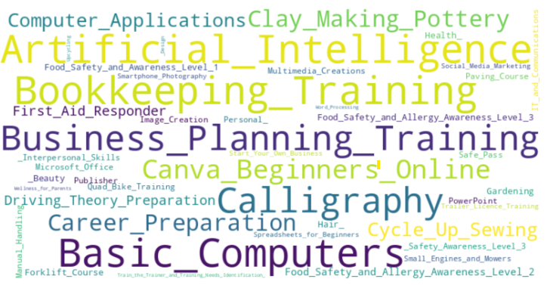
SICAP 2024 End of Year Review SICAP Programme 2024-2028

Slide 12
SICAP 2025 Annual Plan SICAP Programme 2024-2028
Total Budget €897,248
 | 2025 Budget | Goal 1 Action Costs | Goal 2 Action Costs
SICAP | €775,836 | €250,369 | €331,507
New Arrivals | €121,412 | €29,074 | €61,984
Annual Targets | Proposed Target
KPI 1 | 45
KPI 2 | 450
LPTG | 27%

Slide 13
SICAP 2025 Annual Plan SICAP Programme 2024-2028
Pobal Feedback
The KPI targets set are relevant to the focus of each action
There is clear focus in the 2025 on the LPTG
Support for New Arrivals is built into the plan, targeting IPAS and other migrant communities
The rationale and action description for each action continuing into 2025 has been updated
Sub Committee Recommendations
Recommend to LCDC approval of 2024 End of Year Review
Recommend to LCDC approval of 2025 Annual Plan
Increase KPIs
KPI 1 to 45
KPI 2 to 450
Proposed By: Seconded by:

Slide 14
Healthy Ireland –Update by Eamon Hannan

Slide 15
Healthy Ireland 2025 Funding
Existing Healthy Roscommon SLA’s (Year 3)
LEADER - €12,000
Roscommon Sports Partnership - € 22,000
New SLA for 2025 with Traveller Health Project for €10,000
Total of 33 eligible applications totalling €130,000 received for small grants fund of €20,000.
Decision taken to increase funding allocation to €32,420 given the volume and quality of applications.
Following evaluation process funding allocated to 8 projects with further detail requested on 1 additional project.

Slide 16
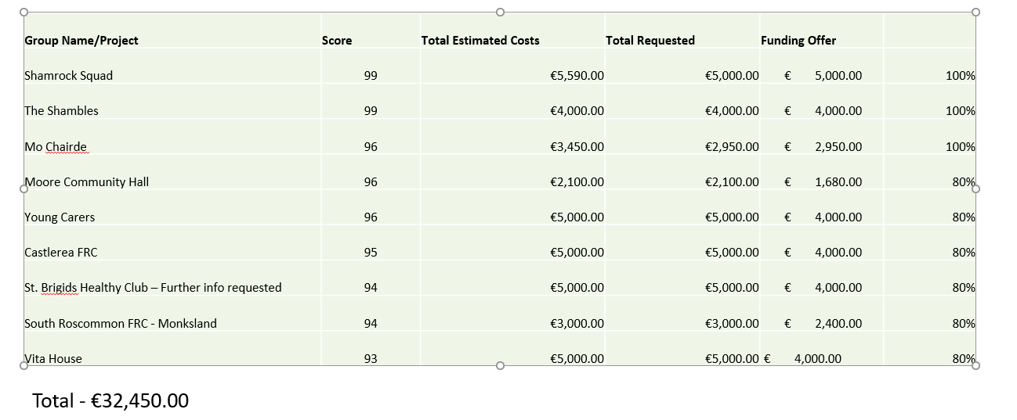
Approved Applications

Slide 17
Healthy Roscommon Update
Menowell programme now in 5th week with 275 participants registered across the county.
Lough Funshinagh Rise and Thrive project shortlisted for LAMA award in Community Mental Health category.
Work now commencing on community resilience tool kit, will include learnings from Storm Eowyn as well as Lough Funshinagh project & attendance at InterReg Conference on Resilience in Flooding & Extreme Weather with the support of Healthy Ireland & WHO
2024 Pobal Reporting for submission on Feb 28th

Slide 18
Healthy Roscommon Update
Taking Stock Farmer Health Project to launch on Thursday March 6th
This is a collaborative project across Healthy Galway, Mayo & Roscommon
Being delivered in partnership with HSE Health & Wellbeing, Roscommon PPN, Teagasc & Croí
Taking Stock Awareness campaign will focus on
Succession Planning
Financial Wellbeing
Cardiovascular Health
Work/Life Balance
Series of 4 editorials in local newspapers & education slot on Agriview on Shannonside FM with well being events at Marts & Co-ops later in 2025.
Will compliment our Fit Farmers programme which continues, application made for Adult Literacy Grant to develop companion materials for the programme with GRETB & Roscommon Libraries.

Slide 19
Funding Updates by Cathriona MacCarthy
Local Enhancement Programme 2025 * Online applications for LEP 2025 opened Mon 6th Jan with closing 5th Feb * A live training webinar was hosted on Jan 15th with support from the PPN A step by step training video on the online application process was made available on the RCC website after the webinar Over 140 applications were received and are currently being validated. Most applications sought funding under both Capital and Operating elements. Community Recognition Fund 2024 – Window 3 (CRF) The application for Expression of Interest (EOI) Window 3 was live from 16th December 2024 until 17th January 2025. The Department extended the deadline so the revised deadline was 24th January 2025. As a result of storm Eowyn, and difficulties experienced by individuals and groups to submit, the final closing date was Monday 27th January. A live training webinar was hosted on January 8th with support from the PPN. 22 groups were represented. A step by step training video on the Expression of Interest process was made available on the RCC website after the webinar 34 expressions of Interest were received. 15 were new applications 19 were groups who submitted EOI’s from Window Evaluation Committee Meeting took place on 30th January review to the projects. It was agreed that they top 4 projects would be put forward to the Department for their approval. Closing date for submission of same is 28th February 2025.

Slide 20
Funding Updates by Cathriona MacCarthy
Empowering Communities – 3 year programme, located in Castlehill, Castlerea. Recruitment Update Community Engagement & Events Resident Support & Issues Raised Operational Update

Slide 21
Other Updates by Cathriona MacCarthy
Local Community Safety Partnership (LCSP) Pat Flanagan commenced in his role as Coordinator of our LCSP on 24th February Niamh Duffy commenced in her role as Administrative Support on 10th February

Slide 22
Any Other Business
LAMA All Ireland Community & Council Awards 2025 took place on 22nd February in Rochestown Park Hotel.
Shortlisted nominations from Roscommon County Council
Community Volunteer of the Year- Bernie Kearney
Best Enterprise & Start-Up Hub- An Chistin Food Hub
Best Community Transport- Roscommon Community Bus Initiative (Ballaghaderreen)
Best Town or Village Regeneration- Roscommon Town Public Realm
Most Inclusive Project- North Water Accessible Kayaking
Best Mental Health- Lough Funshinagh Rise and Thrive Project

Slide 23
Next meeting of Roscommon LCDC
26th March 2025 @3pm
Hybrid- Castle Suite/MS Teams

