Slide 1
Meeting of the Local Community Development Committee (LCDC)
25th February 2026.
Quorum:
Apologies: Fiona Ní Chuinn and Louise Ward
Correspondence:
Minutes of previous meeting dated 11.12.25
Proposed by:
Seconded by:

Slide 2
Matters arising
Cllr. Laurance Fallon
Any matters arising

Slide 3
Conflict of Interest Forms
Chris Flynn
Conflict of Interest Forms 2026
  As per the 2327 Operating Rules - 5.4.6 Conflict of Interest
LAG decision making members, LAG Evaluation Committee members, and the staff of LAGs and their Implementing Partners/Animating Partners must complete
(i)the Annual Conflict of Interest Declaration template (appendix 25) and
(ii)the Register of Interests Declaration template (appendix 26). The Authorised Officer is responsible for ensuring compliance with these requirements.
  Thank you to those of you who have already returned the required documents. Bridie will pass copies to sign to those of you who have yet to sign.
Conflict of Interest Forms 2025
  Audit took place on 17th December by Adrian Hynes from DRCDG- Pass

Slide 4
SICAP – Update
SICAP Presentation
By Donal Walsh GRETB

Slide 5



SICAP 2024-2028 Programme
2025 End of Year Review
2026 Annual Plan Review
Update by: Donal Walsh (GRETB)

Slide 6
The Aim
The aim of SICAP is to reduce poverty and promote Social Inclusion and Equality in Ireland through supporting communities and individuals.
SICAP Core Principles
An Equality Framework
Community Development Approaches
Collaborative Approaches

Slide 7
SICAP 2025 - End of Year Review
Pobal Feedback
SICAP exceeded KPI targets, supporting 71 communities (158%) and 542 individuals (120%)
There has been strong engagement with disadvantaged communities, 34% of caseload coming from priority areas.
All SICAP actions were fully completed, demonstrating consistent delivery across community, training, integration, and wellbeing supports.
New Arrivals received extensive support, including over 500 interpretation sessions, cultural events, and targeted employability programmes.
Financial compliance was strong, with admin costs, grants, and spending all within required thresholds.
The end of year financial and monitoring report for Roscommon County (30-1) has been reviewed and is ready for the LCDC to formally approve.
Sub Committee Recommendations
Recommended to LCDC - approval of 2025 End of Year Review
Proposed By: ________________________ Seconded By: ________________________

Slide 8
SICAP 2025 - End of Year Review – Highlights
Total Budget: €897,248
 | 2025 Budget | Spend | +/-
SICAP | €775,836.00 | €773,182.65 | €2,653.35
New Arrivals | €121,412.00 | €121,369.49 | €42.51
Annual Targets | Target | Achieved | % Achieved
KPI 1 | 45 | 71 | 158
KPI 2 | 450 | 542 | 120

Slide 9
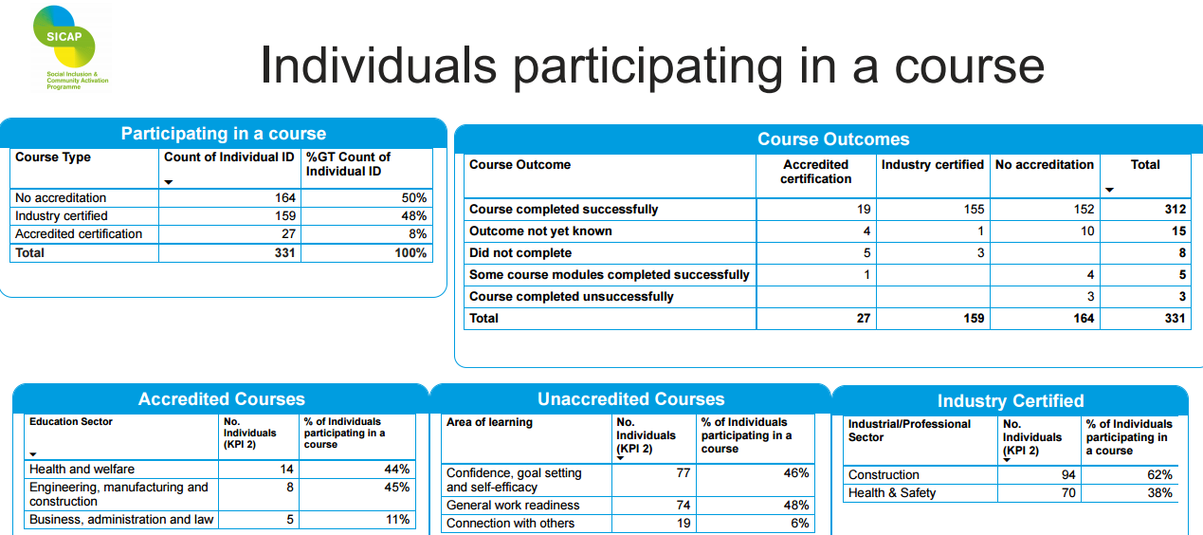
SICAP 2025 - End of Year Review - Highlights

Slide 10
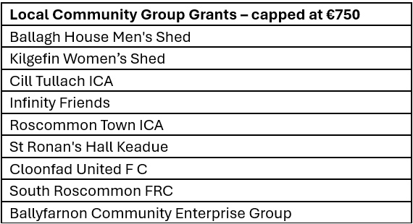
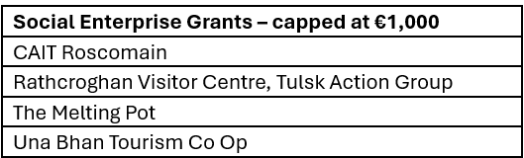
2025 SICAP End of Year Review - Grants Awarded

Slide 11
SICAP 2026 - Annual Plan
Total Budget: €921,019
 | 2026 Budget | Goal 1 Action Costs | Goal 2 Action Costs
SICAP | €799,607.00 | €263,649.88 | €336,055.41
New Arrivals | €121,412.00 | €29,100.57 | €61,958.43
Annual Targets | Proposed Targets
KPI 1 | 45
KPI 2 | 450
LPTG | 27%

Slide 12
SICAP 2024-2028 Programme
SICAP 2026 Annual Plan
Pobal Feedback
The KPI targets set for 2026 are achievable, with the plan demonstrating strong capacity to meet and exceed expected outputs across both Goal 1 and Goal 2.
There is clear evidence throughout the 2026 plan that people living in disadvantaged communities remain the core Local Priority Target Group.
The plan provides strong support for New Arrivals through its dedicated actions. Targeting includes migrant communities and refugees.
Sub Committee Recommendations
Recommended to LCDC - approval of 2026 Annual Plan
Proposed By: _____________________________ Seconded By: ______________________________

Slide 13
LCDC Membership update by Chris Flynn
Helen Hunt – Brothers of Charity Representative – 3 year term ceased 19.12.25. We reached out the Brothers of Charity to see if Helen was to continue as the nominee for the group or if they wished to put forward a new nominee. Maria Murphy – Roscommon Services Sector Manager confirmed on 20.01.26 that her membership would continue for a further 3 years
Pat Compton– Irish Congress of Trade Unions– 3 year term will cease 27.02.26. We reached out the Irish Congress of Trade Unions to see if Pat was to continue as the nominee for the group or if they wished to put forward a new nominee. Owen Reidy – General Secretary confirmed on 20.01.26 that Congress wished to re-nominate Pat for a second three year term on the LCDC.
Grant Evaluation Sub Committee:
  LCDC has an Grant evaluation sub committee that adjudicate on grants.
  Committee members were Shane Tiernan, Cllr. Laurence Fallon and the late Michael Ewing (R.I.P.) We are looking for a Private Community representative of the LCDC to replace Michael on this committee.

Slide 14
LECP Update update by Chris Flynn
LECP 2023-2029 – Next Steps
Work on the review document is now nearing completion. The next phase will involve examining the existing Action Description within the LECP to determine whether they should be updated, amended, or whether new actions are required. Since the LECP was first adopted, societal and local circumstances may have evolved, and this review phase allows us to reflect those changes (e.g., Integration, Local Community Safety Partnership).
We will also explore the development of a social media campaign or platform to engage with the public, gather their feedback, and identify whether additional action items should be considered.
In addition, statistical insights from the CSO and Maynooth University will be available to support our analysis and may inform any adjustments needed to our action points.

Slide 15
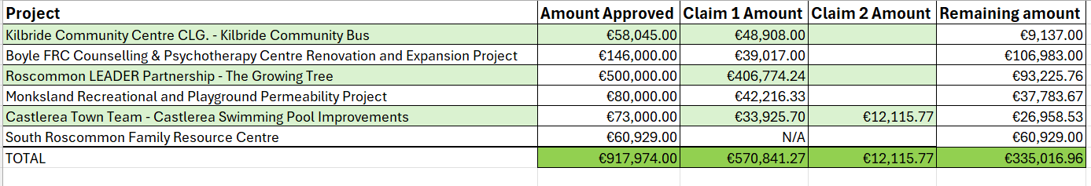
Funding Updates by Chris Flynn
Local Enhancement Programme (LEP)- For Noting LEP 2025 – Budget of €151,685.62. €144,417.75 spent out of budget. 125/127 grant claims paid out on. We have submitted request to Department that remaining €7,267.87 from 2025 can be rolled over into LEP 2026 budget. LEP 2025 is now closed. LEP 2026 – Closing date for applications is Friday 27th February. Budget for 2026 is €153,829.73. 59 applications have been received as of this morning with amount totalling €180,961.11. Significantly more applications are expected in the final days prior to the deadline (44 applications on system in draft format). Community Recognition Fund (CRF) 2024 Communications continue to happen between RCC, the DRCDG and the Community Groups. Progress meetings are currently being scheduled with the groups to see how they are progressing as the Fund draws to a close in November this year.

Slide 16
Any Other Business

Slide 17
Next meeting of Roscommon LCDC
Wednesday 22^{nd April} 2026 @3pm
Hybrid Meeting
Loughnaneane Suite/MS Teams

