Slide 1
Meeting of the Local Community Development Committee (LCDC) 21st May 2025.
Quorum:
Correspondence:
Minutes of previous meeting dated 26.03.25
Proposed by:
Seconded by:

Slide 2
Matters arising Update by Fiona Ní Chuinn
Any matters arising

Slide 3
LCDC Membership update by Bridie McHugh
Social Inclusion Representative – Roscommon Women’s Network (RWN) who are a current Social Inclusion PPN member, responded to the call for nominations and put forward Martina Hourigan from their group as a nomination for the vacant seat. Her nomination has been verified and will be ratified at PPN Plenary meeting on May 28th, 2025. This will then be ratified at the Council meeting of 23rd June. It is hoped that Martina will be in attendance for our July meeting.
Annual Conflict of Interest Form– Forms available for completion.
For the delivery of the 2023 - 2027 LEADER Programme in Roscommon, all decision-making members shall be aware of the rationale for having a policy on possible conflict of interest. It is essential to ensure that no member of staff can influence decisions in any way that may be to their advantage. Additionally, it is necessary to reassure the public that all decision making is fair and above board. Finally, a policy acts as a protection to the members and staff against any possible allegation that they may have used their position to their own advantage.
When must this Annual Conflict of Interest Declaration be completed
An Annual Conflict of Interest Declaration must be completed in January of any given year and the information provided must relate to the period 1st of January to 31st December of the previous year.
Who must complete the Conflict-of-Interest Declaration
The 2023 -2027 LEADER Operating Rules, section 5.4.6, refers to the Conflict-Of-Interest procedures to be followed by all LAG decision making members, LAG Evaluation Committee members, and the staff of LAGs and their Implementing Partners/Animating Partners.

Slide 4
Roscommon LCDC Annual Report 2024
Fiona Ní Chuinn, Chief Officer
21st May, 2025.

Slide 5
Introduction & Governance
Legal basis: Local Government Act 2014 (S128E(4) of the Local Government Act 2001)
Purpose: Review of LCDC functions and progress for 2024
Key statutory responsibilities of LCDC

Slide 6
Membership & Meetings
Overview of LCDC structure (statutory & non-statutory members)
Membership changes post-Local Elections 2024
Attendance: 8 meetings, average 79% attendance

Slide 7
Programme Oversight Summary
Programmes overseen: SICAP, LEADER, LEP, LECP
Key highlights: Programme launches, funding, community engagement
Role as Local Action Group (LAG) for LEADER

Slide 8
SICAP 2024–2028 Performance
Total Budget: €810,978 (2024)
Implementing Partner: Roscommon LEADER Partnership
KPIs: 129% (communities), 131% (individuals)
35.7% of individuals from disadvantaged areas

Slide 9
LEADER & Local Enhancement Programme (LEP)
LEADER funding: €1.84M drawn down/committed between the old and new programme
30 promoters paid, old programme, (€0.89M).
15 projects approved, new programme, (0.98M).
LEP 2024: €138K allocated, 120 projects approved & completed

Slide 10
LECP 2023–2029 Implementation
Consultation: 7,000+ people engaged
6 High Level Goals with SCOs & SEOs
Monitoring via QR system and online forms
Interim reviews planned

Slide 11
Community Health & Wellbeing
Facilitated by the Health and Wellbeing Subcommittee
Healthy Ireland: €75K investment
Projects: Fit Farmers, Pride Colour Run, Connect Cafés
Strategy development for Healthy Roscommon 2025

Slide 12
Youth, Age Friendly & Inclusion
Comhairle na nÓg: Focusing on Mental Health and Educational Pressures
Age Friendly: OPC events, Memory Café, Walkability Audits
Dormant Accounts: €10,100 for LGBTI+ inclusive initiatives
Empowering Communities Programme: €420,000 over 3 years
Migrant Integration Strategy: under review for alignment with national updates

Slide 13
Conclusion
Strong interagency cooperation & programme delivery
Continued implementation of LECP, SICAP, LEADER
LCDC consideration for approval of report on 21 May 2025
Proposed by:
Seconded by:

Slide 14
SICAP update by Fiona Ní Chuinn
SICAP
Climate Justice Support Workshop, Hodson Bay Hotel Athlone, 13th May 2025
Climate Justice is now a Horizontal Principle and Climate Action and the Just Transition is a Thematic Focus Area of SICAP 2024-2028. As this is a relatively new area of work within the programme, Pobal and DRCD are organising three Regional Support Workshops for frontline LDC and LCDC staff on Climate Action and Climate Justice. It was also very evident at our Local Support Workshops last year that there was a real interest from you all in seeking further programme supports in this area. The purpose of the workshop is to share learning and experiences on the delivery of supports and initiatives to marginalised communities

Slide 15

Health and Wellbeing Committee
May 21st 2025

Slide 16

Healthy Ireland Update – Eamon Hannan
2024 Financial Return approved by Pobal.
HIF funding received ( 90% 2025 allocation & 10% 2024 allocation) – Totalling €75,000
This funding has been allocated as follows as agreed by Health & Wellbeing Sub Committee
Roscommon Sport Partnership SLA €22,000
Roscommon Leader Partnership SLA €12,000
Traveller Health Project SLA €10,000
Taking Stock Campaign € 2,500
Small Grants Projects €29,450 (8 community projects across the county)
External Evaluation € 3,000
Total Planned Spend for 2025 € 78,950 (10% Balance due from Pobal at end of 2025)

Slide 17
2024 Progress Report - Eamon Hannan
Very positive feedback from Pobal on achievements in Roscommon
Healthy Roscommon has made strong progress across both outcomes, with the physical activity outcome fully completed and showing substantial participation levels.
The alignment between the Annual Activity Workplan and the 2024 progress report is strong, with both documents demonstrating a shared vision and commitment to sustained impact. The planning for 2025 demonstrates a clear continuation and development of the work. Healthy Roscommon is delivering valuable work that contributes meaningful to local health and well-being.
Well done on this submission, it’s a testament to the hard work of Healthy Roscommon and your partner organisations. We wish you the best as you continue the delivery into 2025
Many Thanks to the LCDC & Subcommittee for your ongoing support in supporting and championing the Healthy Roscommon agenda in your communities.

Slide 18
Healthy Ireland Update – Eamon Hannan
Community Resilience Toolkit – work is underway on the community resilience toolkit. A short consultation will take place at the upcoming PPN Plenary where Community Resilience will form part of the panel discussion. Collaborative work on developing a 5 pillared framework for community response in ongoing with the PPN with a draft to be ready by Early August and autumn educational roadshows planned with PPN & RLP support.
Breast Feeding Friendly Roscommon : A committee has been formed chaired by Fiona Quinn ADPHN.
- This committee is comprised of PHN’s, GP’s, Lactation Consultants, HI Coordinator, Breastfeeding Support Gp representatives.
The Aim of the committee is to support the uptake of Breastfeeding across Roscommon through the roll out of the ‘We are Breastfeeding Friendly’ National Framework. The development of a single easy to access information source on Breastfeeding supports in Co. Roscommon.

Slide 19

Taking Stock Initiative - Eamon Hannan
Very Positive Response to the initiative.
- We are creating a mini podcast from the content developed for the March radio shows to publish and circulate more widely
- As part of Men’s Health Week we are running an event at Roscommon Mart on June 13th. This will comprise of information stands, health checks, short education pieces from the ‘ring’.
- We have commenced a project of work with the RSS to roll out this information to their 200 participants across Roscommon.

Slide 20
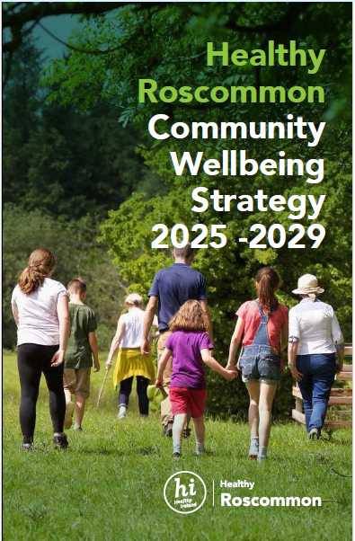
Healthy Roscommon Community Wellbeing Strategy 2025 – 2029 (Presented by Aisling Dunne)
The Vision for Healthy Roscommon
“Through implementation of the Healthy
Roscommon Community Wellbeing Strategy we
will foster a community where wellbeing is a
shared value and responsibility can lead to a
healthier, more connected society. This will ensure
Roscommon is a vibrant, connected and inclusive
place to live and work.”

Slide 21
Healthy Roscommon Community Wellbeing Strategy 2025 - 2029
Building on the Healthy Ireland Strategic Plan 2021- 2025 and the Round 4 Local Strategy for Roscommon, we have identified the need for a new, cohesive Healthy Roscommon Community Wellbeing Strategy.
This updated plan will prioritise health and wellbeing across the county, addressing both immediate and long-term outcomes.
It will extend beyond the two current Healthy Ireland-funded outcomes, ensuring comprehensive representation of all key priority focus areas through 2026 and beyond.
Our clear aim is to create a Healthy Roscommon that not only meets but exceeds expectations for public health and community wellbeing.

Slide 22
Key Priorities for a Healthy Roscommon
From our extensive consultation exercises, we identified seven key priorities that will drive this strategy. These priorities are at the heart of our plan, each addressing critical areas for improving community health and wellbeing
1. Community
2. Physical Activity
3. Social Inclusion
4. Mental Health for all
5. Safety for All
6. Equity and Equality
7. Evidence-Based Actions for Improvement

Slide 23
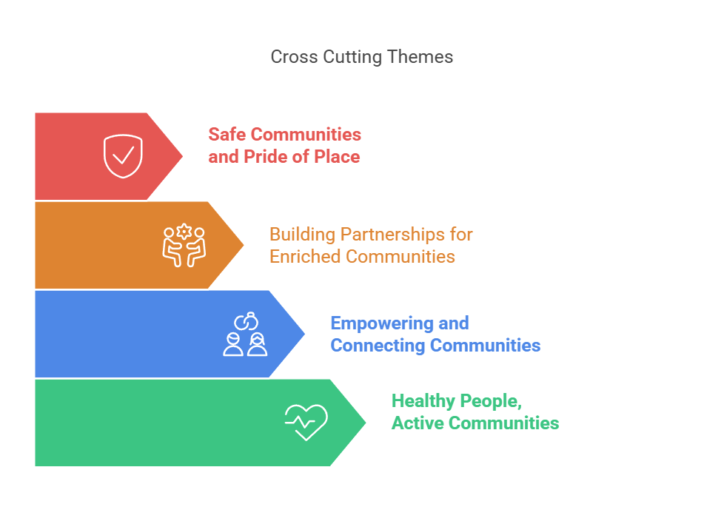
Four Cross Cutting Themes

Slide 24
Implementation & Monitoring
Roscommon LCDC is the governance structure that will publish and monitor the delivery of the Healthy Roscommon Community Wellbeing Action Plan
The LCDC, via The Health and Wellbeing sub-committee will also remain responsible for the overall governance of the Healthy Ireland Fund applications and administration of funding for the duration of the strategy.
The Healthy Ireland Co-Ordinator for Roscommon will continue to provide updates to the LCDC via the Chair of the Health and Wellbeing subcommittee bi-monthly with respect to the overall management and administration of the Healthy Ireland Fund projects and delivery of the Healthy Roscommon Framework and annual work plans & will also publish an annual plan and annual report to the LCDC for the duration of the strategy.

Slide 25
Funding Updates by Fiona Ní Chuinn
Community Recognition Fund (CRF) 2024 –Window 3 Projects were submitted to the Department on 28th February 2025 These are still being reviewed by the Department No date has been for confirmation of successful projects

Slide 26
Any Other Business
December Meeting Date Change
Potential LCDC Meeting date change from Wednesday 10th December
to Thursday 11th December (Fiona Ní Chuinn)
LCDC Internal Focus Group (Bridie McHugh)
Focus Group
As part of the Department’s ongoing efforts to enhance the awareness and understanding of Local Community Development Committees (LCDCs), the Department of Rural and Community Development has engaged Match Marketing to develop a communications campaign to be rolled out later this year. The 1st part of this was LCDC Internal Focus Group in Tullamore 31st March which Cathriona MacCarthy and Bridie McHugh attended along with Councillors, stakeholders and counterparts from other councils.
Survey
The 2nd stage of this was the LCDC Communications survey titled ‘Help us to improve how LCDC’s connect with your local community’. The Department advised that they were currently in the ‘discovery phase’ of this project, which seeks to gather valuable insights from key stakeholders. Your participation in this phase is critical in helping shape the direction of the campaign and ensuring it aligns with the needs of communities and stakeholders
This survey was emailed to all members on 2nd May for completion by 16th May. A further reminder sent out to all on the 12thMay. A further communication was sent out by the Department on 16th May to advise that the deadline was extended to Friday 23rd May so you still have time to complete if you haven’t already done so.

Slide 27
Next meeting of Roscommon LCDC
16th July 2025 @3pm
Hybrid- Castle Suite/MS Teams

