Slide 1
Meeting of the Local Community Development Committee (LCDC)
16th July 2025.
Quorum:
Correspondence:
Minutes of previous meeting dated 21.05.25
Proposed by:
Seconded by:

Slide 2
Matters arising
Update by Fiona Ní Chuinn
Any matters arising

Slide 3
LCDC Membership update by Bridie McHugh/Fiona Ní Chuinn
We now have our full complement of representatives on the LCDC Committee. Our most recent vacant position for Social Inclusion Representative came from– Roscommon Women’s Network (RWN) who are a Social Inclusion PPN member. Their nomination Martina Hourigan was verified, ratified at PPN Plenary meeting on May 28th and further ratified at the Council Meeting of 23rd June.
John Bergin – Business representative and Martina will now go through the education with Tomás Beades and Cathriona MacCarthy at a date to be confirmed.
Lynne Keery – GRETB – Letter of resignation received.

Slide 4
SICAP – Mid Year Review
Lynne Keery

Slide 5
SICAP 2024-2028 Programme
Annual Plan 2025 Review
Mid Year Review 2025
SICAP has Two Goals
Goal 1: Supporting Communities
Goal 2: Supporting Individuals
Notes:
Pobail Provide Plan Appraisal Document and Guidelines which the sub committee used.
Financial Check was completed as per guidelines and we confirm that all is as it should be
POBAL also undertook financial review which has returned as satisfactory
All actions have the related LECP Objective named against it
Staffing Resource Schedule has been completed according to Pobail guidelines
The review team read every action against the review criteria and the guidelines and did come up with a few anomolies / areas requiring clarification

Slide 6
The Aim
The aim of SICAP is to reduce poverty and promote Social Inclusion and Equality in Ireland through supporting communities and individuals.
SICAP Core Principles are:
An Equality Framework
Community Development Approaches
Collaborative Approaches
Notes:
Pobail Provide Plan Appraisal Document and Guidelines which the sub committee used.
Financial Check was completed as per guidelines and we confirm that all is as it should be
POBAL also undertook financial review which has returned as satisfactory
All actions have the related LECP Objective named against it
Staffing Resource Schedule has been completed according to Pobail guidelines
The review team read every action against the review criteria and the guidelines and did come up with a few anomolies / areas requiring clarification

Slide 7
SICAP 2024 - 2028
Funding: Department of Rural and Community Development with co-funding from the ESF.
National Management
& Oversight: Pobal
Contracting Authority: LCDC’s
Programme Implementer (PI) : Deliver SICAP at local level as per actions in the Annual Plan
Notes:
Pobail Provide Plan Appraisal Document and Guidelines which the sub committee used.
Financial Check was completed as per guidelines and we confirm that all is as it should be
POBAL also undertook financial review which has returned as satisfactory
All actions have the related LECP Objective named against it
Staffing Resource Schedule has been completed according to Pobail guidelines
The review team read every action against the review criteria and the guidelines and did come up with a few anomolies / areas requiring clarification

Slide 8
Annual Plan 2025
KPI Targets
KPI 1 is set at 45 and KPI 2 target set at 450.
The target for Disadvantaged Communities is set at 27%.
Notes:
Pobail Provide Plan Appraisal Document and Guidelines which the sub committee used.
Financial Check was completed as per guidelines and we confirm that all is as it should be
POBAL also undertook financial review which has returned as satisfactory
All actions have the related LECP Objective named against it
Staffing Resource Schedule has been completed according to Pobail guidelines
The review team read every action against the review criteria and the guidelines and did come up with a few anomolies / areas requiring clarification

Slide 9
Annual Plan 2025 – Financial Review
Annual Budget: €897,248.00
Total Administration Costs: €193,959.00 (21.6%) which
equates to less than the permitted level of 25%
Total Action costs (64.9%): €581,877.00
Goal 1 Action Costs: €250,369.71
Goal 2 Action Costs: €331,507.29

Slide 10
Annual Plan 2025 Sub-Committee Review
The subcommittee reviewed the mid year plan as per the guidance document provided by Pobal.
It was agreed by all that the programme implementor (PI) has achieved all relevant benchmarks under both goals.
SICAP and new arrivals costs have been entered separately as per the guidance.
The subcommittee noted that the PI has not yet awarded grants – (Individual and community organisational) and therefore no checks were required under this review.
The PI informed the sub committee that they intend to run their grant programmes in Q3 - Q4 of 2025.
The SICAP subcommittee will review this area at year end.
Notes:
Pobail Provide Plan Appraisal Document and Guidelines which the sub committee used.
Financial Check was completed as per guidelines and we confirm that all is as it should be
POBAL also undertook financial review which has returned as satisfactory
All actions have the related LECP Objective named against it
Staffing Resource Schedule has been completed according to Pobail guidelines
The review team read every action against the review criteria and the guidelines and did come up with a few anomolies / areas requiring clarification

Slide 11
Annual Plan 2025 Sub-Committee Review
There was a query raised about the LECP objectives being used.
Roscommon County Council responded – This is an ongoing project between Pobal and relevant stakeholders to include implementing partner and LCDC to connect SICAP actions with LECP objectives.
Notes:
Pobail Provide Plan Appraisal Document and Guidelines which the sub committee used.
Financial Check was completed as per guidelines and we confirm that all is as it should be
POBAL also undertook financial review which has returned as satisfactory
All actions have the related LECP Objective named against it
Staffing Resource Schedule has been completed according to Pobail guidelines
The review team read every action against the review criteria and the guidelines and did come up with a few anomolies / areas requiring clarification

Slide 12
Mid Year Review 2025
Pobal Review
Administration cost percentage is within the 10-12.5% range for the New Arrival budget.
Administration cost percentage is 13.06% for SICAP, overall the spend is progressing well.
Goal percentage split is within the approved parameters for both the SICAP and New Arrivals.
Pobal identified a budget amount of €1,260.59 under a heading where no budget has been identified.
  The query was forwarded to the Implementing Partner by the Chief Officer – RCC to the Programme Implementor for their information and rectification. The PI are linking directly with Pobal to address this system related issue. No material difference.

Slide 13
Mid Year Review 2025
The Sub Committee acknowledged all the good work that was done on the SICAP Programme in Roscommon.
KPI 1 Target = 45; Actual = 62; % Achieved 138%
KPI 2 Target = 450; Actual = 352; % Achieved 78%
Well done to the RLP board and all the staff who work on the SICAP Programme.

Slide 14
Sub-Committee Recommendation
KPI targets as recommended by SICAP Sub-Committee.
Target Groups – People living with disadvantage in Roscommon with particular focus on the LPTG.
Financial costs in line with guidance.
Recommend Approval of Annual Plan & Mid Year Review 2025.
Recommend that the LCDC receive a presentation from the PI twice a year to allow the work that is being done across the county to be showcased.

Slide 15

Health and Wellbeing Committee - Aisling Dunne
July 16th 2025

Slide 16

Healthy Ireland Update
Healthy Roscommon Strategy has been printed following adoption at last LCDC and is ready for launch in September
Men’s Health Week Event in Mart, Sheep Day Athenry, National Play Day, National Bike Week
Round 4 Programme Funding has been extended into 2026. This will allow for delivery of the new National Healthy Ireland Framework and the establishment of Healthy Ireland Coordinators in each local authority in a permanent capacity.
9 pilot community groups identified to roll out Community Resilience Toolkit across the county following the PPN Plenary where it was discussed as part of the panel discussion. Procurement of training for these groups has commenced and work is ongoing on the toolkit content.

Slide 17
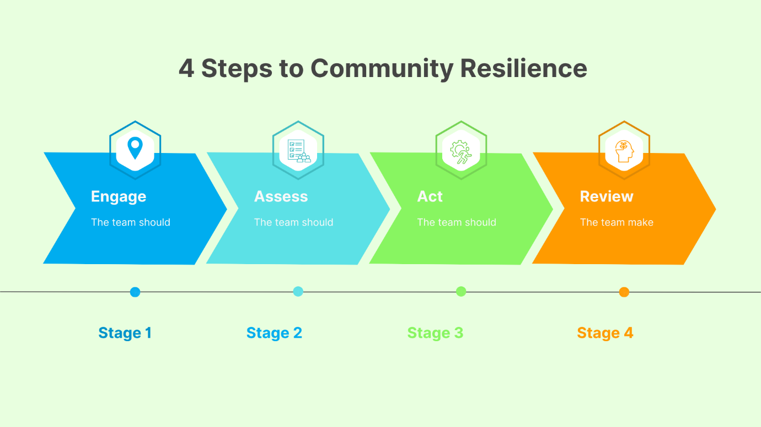
Community Resilience Toolkit will provide resources to:

Slide 18
Toolkit will contain the following
Identify your community – guidance on community scoping
Know your community Stakeholders – identification of key stakeholders and directory development
Assess community skills and resources – key skills to support community
Identify key roles within your community – Roles required to respond to event & associated responsibilities
Develop Community Resilience Response Team: Clear Organogram
Risk Register/Potential Threats – Prefilled Cards
Key locations – community hub, access issues, infrastructure available
Hazard Identification: Health and safety considerations
Vulnerability and Capacity Assessment – Key concerns for community
Cultural Awareness & Inclusive Leadership
What will local authority/Emergency Services response be
Funding requirements
Stage 1: Engage
Stage 2: Assess

Slide 19
The toolkit will contain the following
Stage 3: Act
Stage 4: Review
Meeting Agenda for Response Team
Communication Cascade
Emergency contact template
Emergency Kit contents
Safety Messaging for community
Safeguarding & Duty of Care guidance
Volunteer Supports strategies
Key Stakeholder links for support
Challenges identified
Debrief Guide
Lessons Learned
Adapt to the future
Reporting Template

Slide 20
Training Workshop Focus Areas
Toolkit Use (Resources, Response Team Dev, Leadership Roles)
First Aid Training/Fire Safety/Cultural Awareness
Crisis Communication Skills
Volunteer Resilience
Simulation

Slide 21
LECP Update by Fiona Ní Chuinn
LECP Update – Update on LECP Review 2023 - 2029 Structure Nominee from LCDC to the LECP Advisory Steering Group – Letter from Fiona to members QR Code/Feedback – Print out to be distributed at the meeting and emailed to those on-line

Slide 22
Funding Updates by Fiona Ní Chuinn
Community Recognition Fund (CRF) 2024 –Window 3 Representatives from the various community groups were welcomed to Áras an Chontae on 9th July by our Chief Executive, Shane Tiernan; Director of Services, Chris Flynn; Senior Executive Officer, Fiona Ní Chuinn; Administrative Officer, Cathriona MacCarthy and Community Recognition Fund Administrator, Bridie McHugh. ✅ South Roscommon Family Resource Centre – €60,929 ✅ Castlerea Swimming Pool upgrades – €73,000 ✅ Kilbride Community Minibus – €58,000 ✅ Monksland Playground & Recreation Access – €80,000 Representatives from the groups were; Felicia Loughrey, Roscommon Family Resource Centre Cllr Pascal Fitzmaurice & Susan Gaynor, Castlerea Town Team Tommy Raftery, Bernie Kearney, Ita Kelly and Tom Moran Kilbride Community Centre CLG James Kilmartin, Treasurer, Monksland Town Team & Susan Loughnane, Athlone MD Co-Ordinator Contracts are now being draw up and will be signed over the coming weeks.

Slide 23
Any Other Business
Annual Conflict of Interest Forms – (Bridie McHugh)
For Noting: Local Enhancement Programme (LEP) 2025
Department issued approval for submitted LEP projects on Friday, 13th June. 104 Community Groups received funding under this scheme and all groups have been notified.
Full list of Recipients available at the meeting

Slide 24
Next meeting of Roscommon LCDC
22nd October 2025 @3pm
Hybrid Meeting
Loughnaneane Suite/MS Teams

