Slide 1
Meeting of the Local Community Development Committee (LCDC) 11th December 2025.
Quorum:
Apologies and welcome:
Fiona Ní Chuinn, Louise Ward, Donal Walsh, Martina Hourigan, Pat Compton, Helen Hunt, Eoin Power, Carina Lennon,
Conor Feighan – Administrative Checker
Correspondence:
Minutes of previous meeting dated 22.10.25
Proposed by:
Seconded by:
Election of Chair

Slide 2
Matters arising Update by Cathriona MacCarthy
Any matters arising

Slide 3
SICAP – Update
SICAP Presentation – By Linda Devine
SICAP background and statistics
2 Projects
Ballaghaderreen Community Car
Age Friendly

Slide 4
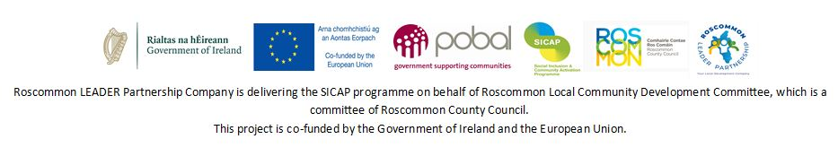
SICAP – Social Inclusion and Community Activation Programme
Nov 2025
Linda Devine
SICAP Manager

Slide 5
Social Inclusion Activation Programme (SICAP) 2024-2028
Funded by the Government of Ireland – Department of Rural and Community Development and Co-funded by the European Social Fund.
The programme aims to reduce poverty and promote social inclusion in County Roscommon by supporting individuals and communities to reach their full potential. It helps people who are unemployed, isolated, or facing disadvantage to access education, training, and employment, while also strengthening local community groups and social enterprises. SICAP aims to ensure that everyone has the opportunity to participate fully in social and economic life.

Slide 6
The SICAP programme is structured over two Goals:
Goal 1 – Contribute to Building more sustainable, inclusive and Empowered Communities. Empower groups of individuals, Local Community Groups and Social Enterprises to address collective community needs.
Goal 2: Empower Disadvantaged People to Improve the Quality of their Lives. Support disadvantaged individuals, children and families to progress their formal education and participate in lifelong learning, to progress into employment/ self-employment, and to improve their soft skills and wellbeing.

Slide 7
SICAP Target Groups
People living in disadvantaged communities
People impacted by educational disadvantage
People living in jobless households or households where the primary income source is low-paid and/or precarious
People who are long-term unemployed
People with a criminal history
Refugees
International Protection Applicants
Disabled People/People with Disabilities
Heads of One-parent Families
Travellers
Roma
Island residents

Slide 8
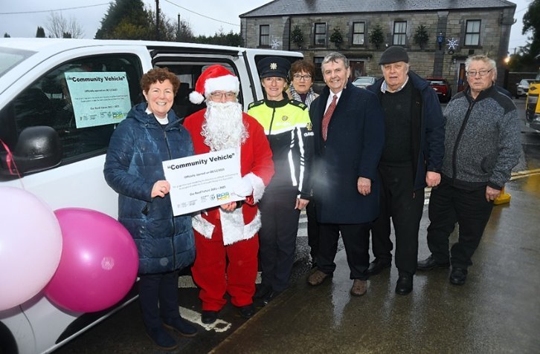
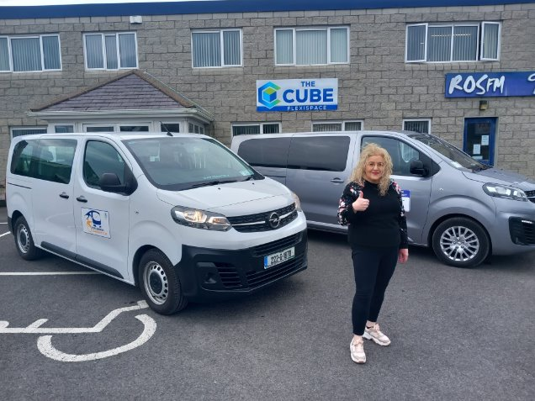
Community Transport

Slide 9
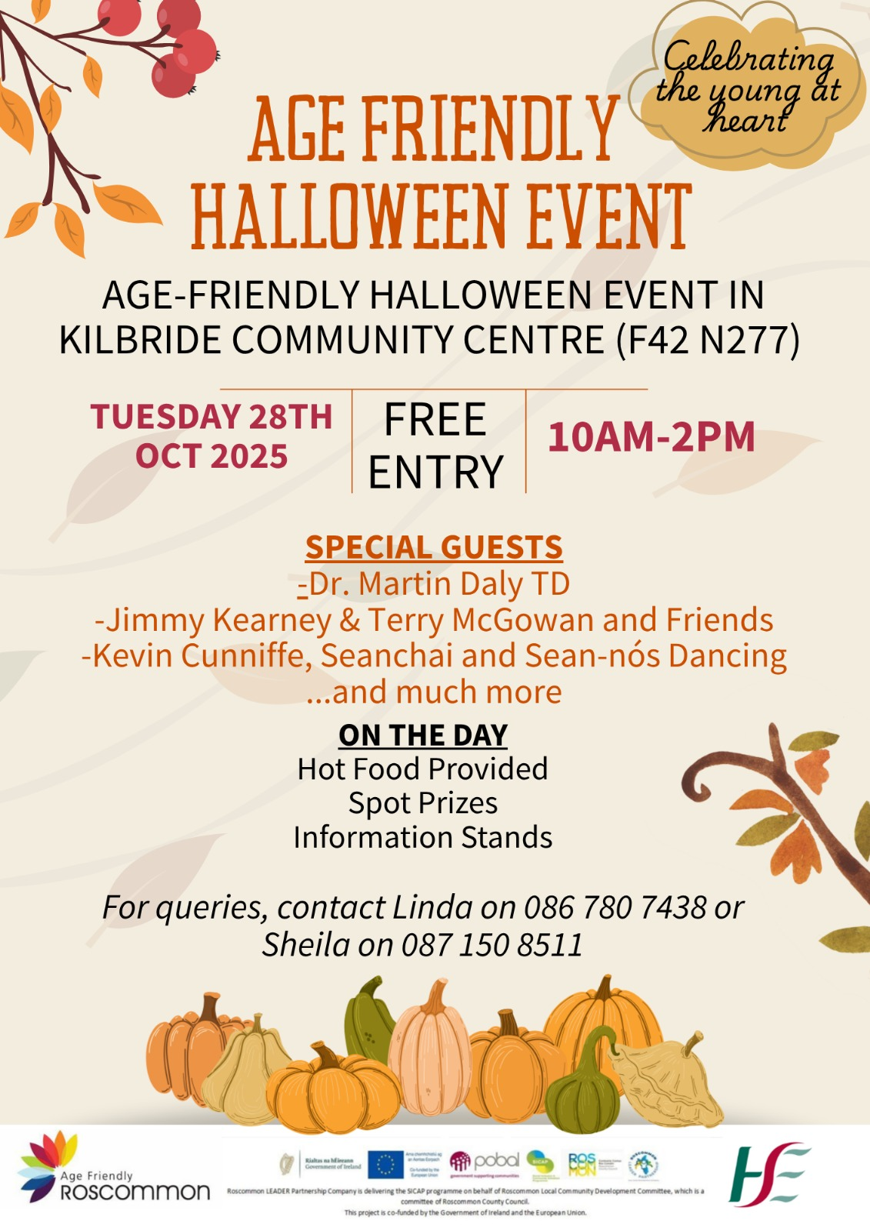
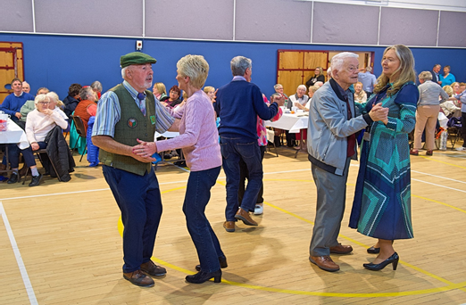
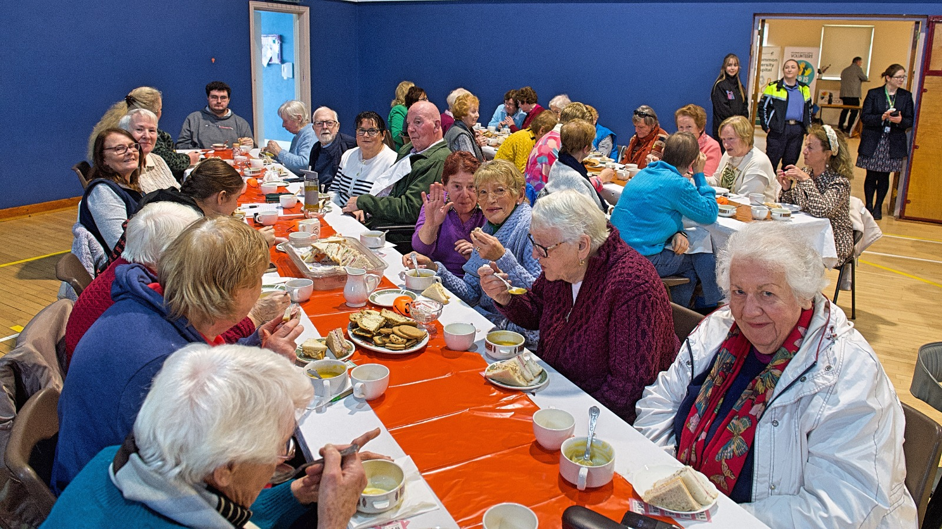
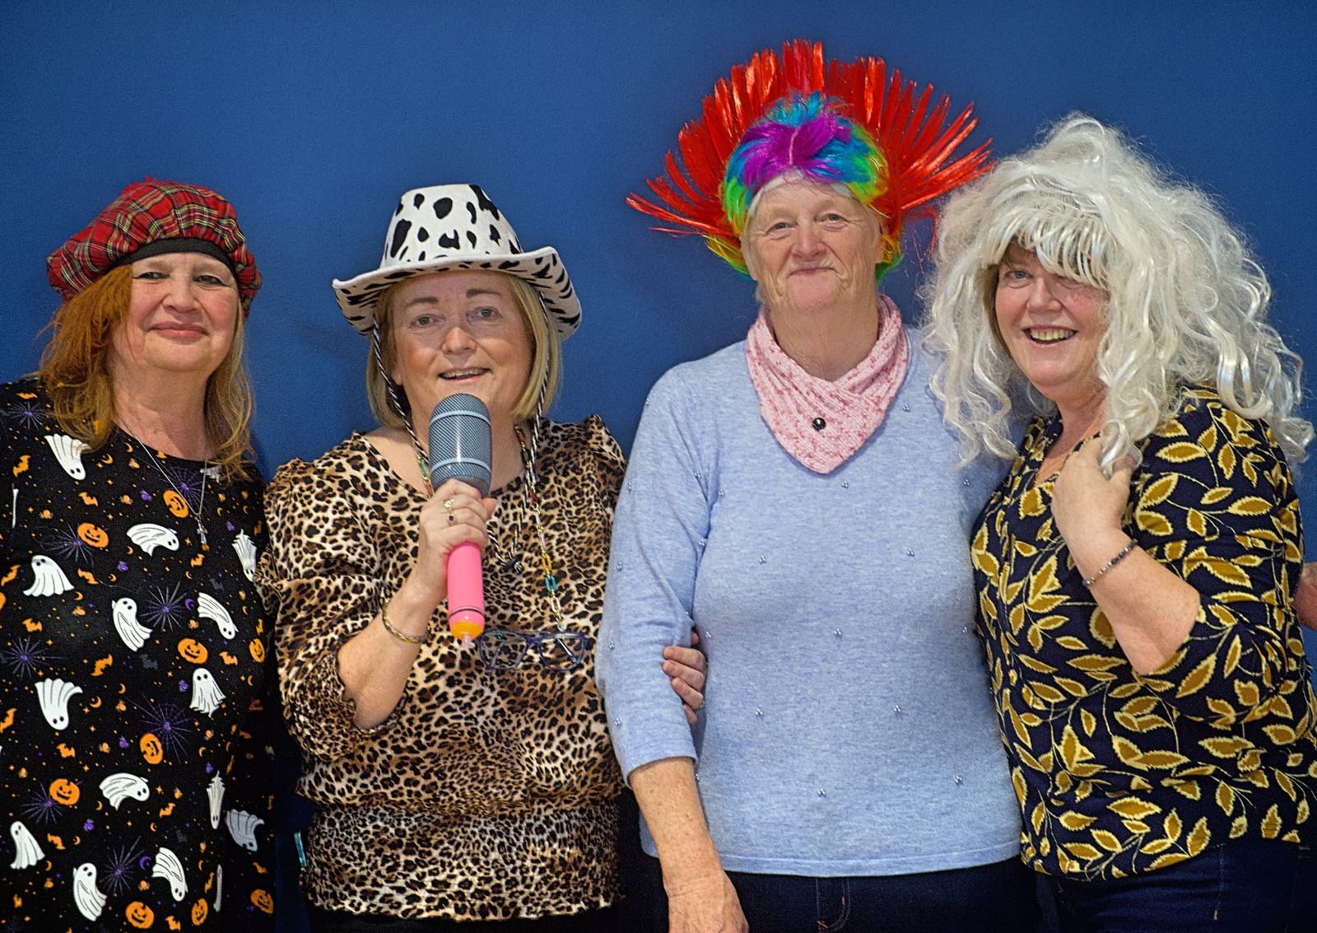
Age Friendly

Slide 10


Age Friendly

Slide 11
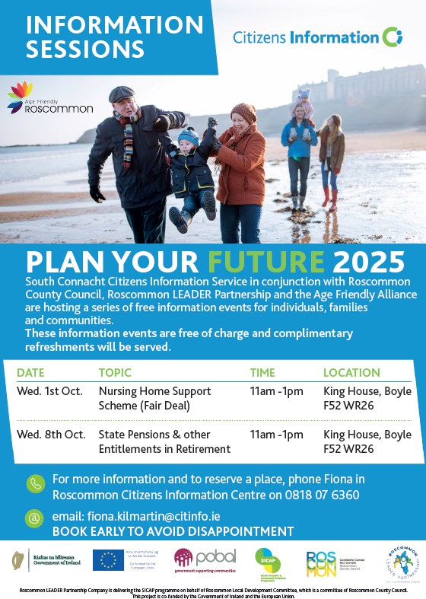
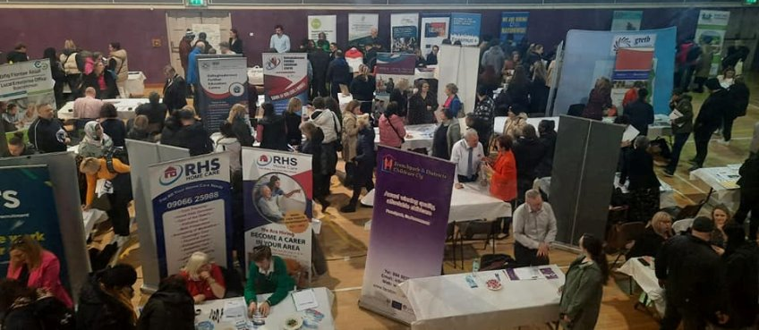





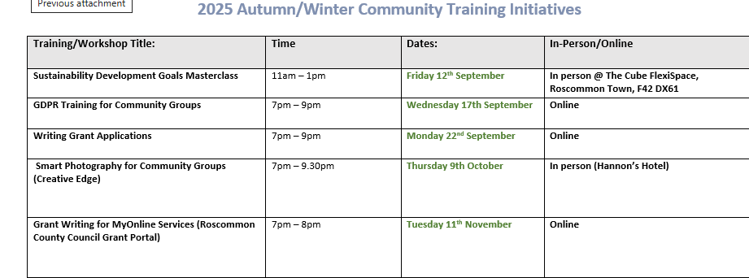
SICAP - A Glimpse of Some Events in the Past Year

Slide 12
Thank You

Slide 13
SICAP – Update Cathriona MacCarthy
Roscommon Leader Partnership – SICAP Social Enterprise Grant
Proposed by:
Seconded by:

Slide 14
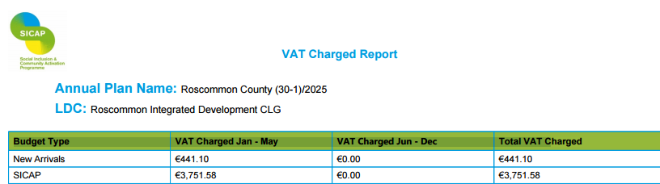
SICAP-Update Sharon Shally
SICAP VAT REPORT – Presented to LCDC for approval
Approved and Signed Off by Chief Officer Fiona Ni Chuinn.
Proposed by:
Seconded by:

Slide 15

Annual Engagement Meeting – 16th October 2025
Attendees:
Donnacha McSorley – Pobal
Linda Devine, Clare Carty – Roscommon Integrated Development Company
Eoin Power – Department of Social Protection
Fiona Ni Chuinn, Cathriona MacCarthy, Sharon Shally – Roscommon County Council

Slide 16
LCDC Membership update by Bridie McHugh
Helen Hunt – Brothers of Charity – 3 year term ceases 19.12.25. We have reached out to Helen and Brothers of Charity to see if Helen will be extending her membership for a further 3 years or if Brothers of Charity will be nominating a different representative. We await their decision.
LCDC Education was completed with Martina Hourigan and Donal Walsh on 17.11.25. It was completed by Fiona and Tomás. 1 member, John Bergin has yet to receive the education but this will happen in the New Year. Bridie will send out suggested dates to John.
LCDC National and Local Communications Campaign – An update meeting took place on 01.02.25 in Ballina. This was in association with the Department and Match Marketing Consultants. It was attended by Fiona Ní Chuinn, Bridie McHugh, Vincent Moran and Kevin Conroy. New Campaign details will be distributed to the point of contacts in Q3.

Slide 17
LECP Update update by Cathriona MacCarthy
Implementation Summary Plan– This was emailed to the LCDC Members and various stakeholders on 28.11.25 – Below extract.
LECP – Next Steps

Slide 18
Funding Updates by Bridie McHugh
Local Enhancement Programme (LEP)- For Noting Claims from approved community group applications are being processed with payment to follow as claims are validated. Conor Feighan is currently working on this programme. Community Recognition Fund (CRF) 2024 All drawdown requests and documentation for Interim Payment 1 for the groups was required to be submitted to the Department by the end of November and this has been completed.

Slide 19
Any Other Business

Slide 20
Next meeting of Roscommon LCDC
Wednesday 25th February 2026 @3pm
Hybrid Meeting
Loughnaneane Suite/MS Teams

