Slide 1
Meeting of the Local Community Development Committee (LCDC) 11th December, 2024.
Quorum: 11 Required
Apologies: Bridie McHugh, Louise Ward, Gabriel Trayers
Correspondence:
For noting. Local Community Safety Partnership (Cathriona MacCarthy)
Minutes of previous meeting dated 23.10.2024
Proposed by:
Seconded by:

Slide 2
Matters arising Update by Shane Tiernan
Social Enterprise Grants – SICAP Goal 1
Advertised on RLP website from 3-10 October 2024
7 applicants, 1 late, 1 ineligible, 5 successful
80% funding to a max of €1,000
Carrick Show Grounds
Roscommon County Development Fund
The Melting Pot
Kilbride Community Centre
Lough Ree Access for All
In total €4,700 was paid out with no one group receiving in excess of €2,500 as per the programme requirements.

Slide 3
LCDC Membership update by Cathriona MacCarthy
Business Representative –We have been unable to secure a nomination for the Roscommon LCDC through Chambers Ireland. The Chamber in Athlone has tried to encourage candidates, but unfortunately, these attempts have not succeeded (Daniel Traynor – Relationship Executive). Representation was also sought for inclusion on SPC’s. We have therefore been advised by Chambers Ireland to seek representation locally. It will be advertised on Social Media in the next day or 2, in the Roscommon People this week, Roscommon Herald next week. Once we receive nominations, we will be in a position to update the group.
Social Inclusion Representative - Resignation – Rita Kearney. Rita tendered her resignation to LCDC and Social Inclusion Committee. Rita resigned from the RWN Board and this was the nominating body for the PPN and in turn Social Inclusion and LCDC. We are currently liaising with PPN Officer Paul Clabby. He has confirmed that he will be seeking a replacement nomination for same at the January Secretariat meeting.
For noting - October 2024 Plenary of RCC - Resolution
Mr Kevin Coyle(Environmental Pillar –PPN) – Cllr. Laurence Fallon/Cllr. Scahill
Mr. Gabriel Trayers (Teagasc Representative) – Cllr. Callaghan/Cllr. Moylan

Slide 4
SICAP–Update by Janice O’Brien
SICAP LGAS SICAP 2023 Audit is reaching its conclusion and Audit Report to be issued shortly. Internal Audit on SICAP 2023 has been reduced in scale on Department approval and is due to conclude shortly with Audit Report to follow. Social Inclusion week ran from 2nd December to 8th December with a number of events ran by both RCC and RLP. €5,500 in total has been allocated to 12 groups to carry out Social Inclusion Community Events.

Slide 5
Social Inclusion Week 2024 Grants
Group | Amount
Cloonbonniffe NS | €400.00
County Roscommon Disability Support Group CLG | €389.00
Loughglynn Senior Citizens | €500.00
Oran Oir | €450.00
Roscommon Special Olympics Club | €500.00
Infinity friends CLG | €500.00
Ballinlough Granlahan Active Retirement Group | €500.00
Frenchpark Ladies group | €500.00
Ballintuber Active Age | €500.00
Boyle Family Resource Centre | €500.00
Ballinameen and Elphin Womens Shed | €455.00
St Ciarans Community Centre Castlecoote | €350.00

Slide 6
Healthy Ireland –Update by Eamon Hannan/Aisling Dunne
Men’s Health Event
Very Successful Event in Kilbride, focus on Urology and Prostate Health
Approx 200 people in attendance, in partnership with RLP
Lough Funshinagh Update
Identified a link person within the community who is going to engage with Healthy Roscommon to deliver additional support and feedback on Resilience Toolkit in 2025
Visit from Healthy Ireland National Coordinators in Jan to progress this.
Women’s Health Programme
Wellbeing events x 2 as part of Social Inclusion Week
Period Problems workshops in Ballaghaderreen for IPAS & EROC centres
Menopause Information Event Tuesday evening 3rd December – Panel of Speakers
Launch Edufit Menowell Programme for 26th Jan 2025, up to 1,000 participants across the county.
Encourage as Workplace Wellbeing Initiative across the county
Healthy Roscommon Community Wellbeing Plan 2025-2029
Final Draft ready for approval & printing
Launch early in 2025 with Age Friendly Strategy

Slide 7
Healthy Ireland –Update by Eamon Hannan/ Aisling Dunne
Budget Update
Committed & Spent Year to Date - €94,280
2024 – Underspend - €9,660.22 (carrying forward to 2025)
Projects Approved in November Sub Group
Not Around us - €3,000
Keep It Lit, Castlerea Mental Health Event & Connect Café - €2,000
Healthy Roscommon Plan Publication - €2,500
2025 Budget Allocation - €75,000

Slide 8
Healthy Ireland 2025 Work Plan by Eamon Hannan/ Aisling Dunne
- SLA’s in place – RSP: €22,000
– RLP: €12,000
2025 additional SLA – Traveller Health Project - €10,000
Small Grant Fund for 2025 Healthy Roscommon Small Grant Scheme Open for Community & Voluntary Groups (€20,000)
- Grant of €2,000 - €5,000 for projects which benefit Outcome 1 & 2
- Closing Date 18th December 2024

Slide 9
Funding Updates by Cathriona MacCarthy
Community Recognition Fund 2024 (CRF) One project under window 1 has informed RCC that it will not be proceeding and the Department has approved that the allocated funding be added back to the pot for window 3 of the scheme. All other projects approved under window 1 of CRF funding are ongoing. A call for Expressions of Interest under window 3 of CRF funding will be made in December of this year

Slide 10
Local Enhancement Programme 2024 95 Projects have been paid €126,000 under LEP 2024 to date. LEP 2025 has been announced by the Department – Roscommon LCDC has been allocated €131,854 for Capital Projects and €21,976 to support communities with operating costs. This scheme will open in December with a closing date in January 2025.

Slide 11
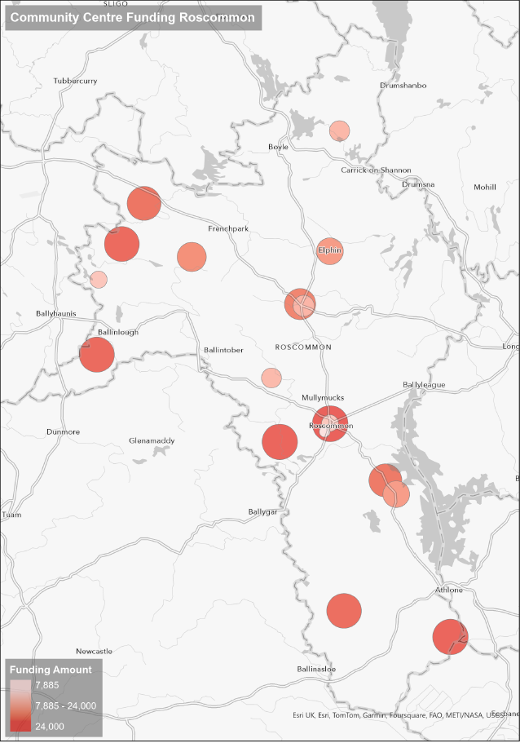
Funding Updates by Cathriona MacCarthy
Community Centre Investment Fund 2024.
Taoiseach and Minister Humphreys announce funding to upgrade 399 community centres across the country. 18 in total for Roscommon.

Slide 12
LECP 2023-2029 Monitoring Update by Cathriona MacCarthy
Level of Engagement: 16 People
17 Groups
28 Updates
Feedback Received: Ongoing
Plans for 2025: Update it live
Update prior to 26th March, 16th July and 10th December

Slide 13
AOB by Cathriona MacCarthy
County Roscommon Heritage Forum
Nomination of LCDC rep to County Roscommon Heritage Forum –EOI
Proposed by:
Seconded by:

Slide 14
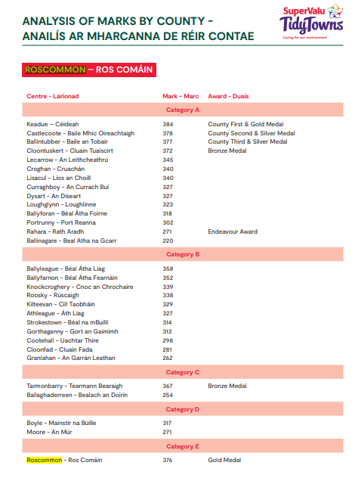
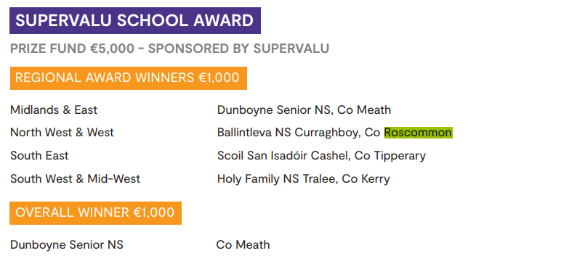
Our Rural Future – For Noting
Minister Humphreys announces Ireland’s Tidiest Town for 2024.
Results for Roscommon.
There were 904 entrants this year.
The County Awards are awarded to the first, second and third placed entrant in each county, The Endeavour Award is awarded to the entrant in each county that made the biggest percentage improvement on the previous year’s score.

Slide 15
Noting by Cathriona MacCarthy
LAMA Nominations
Community Volunteer of the Year – Bernie Kearney
Best Communications Initiative/Innovation – LECP Monitoring
Best Community Wellbeing Initiative – Lough Funshinagh Rise & Thrive Programme
Best Community Transport Initiative – Community Bus

Slide 16
Any Other Business

Slide 17
Next meeting of Roscommon LCDC
26th February 2025 @3pm
Hybrid- Castle Suite/MS Teams

Slide 18
Wishing you and your family a very Happy and Peaceful Christmas and Health and Happiness for the
New Year

