Slide 1
Meeting of the Local Community Development Committee (LCDC) 23rd October, 2024.
Quorum
Correspondence:
Minister Joe O’Brien officially launches Training Needs Assessment Reports for the Community and Voluntary Sector
Minutes of previous meeting dated 18.09.2024
Proposed by:
Seconded by:

Slide 2
Corporate Plan 2024 -2029
Consultation Presentation to LCDC
23rd October 2024

Slide 3
Roscommon County Council is developing a Corporate Plan for the period 2024-2029. The Corporate Plan sets out the strategic framework for all of our services for the people of County Roscommon.
The Corporate Plan sets out a vision and mission statement for Roscommon County Council, supported by our values, goals, priority objectives, supporting strategies and activities. We will be developing Annual Service Delivery Plans to implement the Corporate Plan.
We are developing the Corporate Plan in collaboration with internal and external stakeholders, including the LCDC. Your feedback will be used to create the Corporate Plan for Roscommon County Council over the next 5 years.

Slide 4
Corporate Plan 2024 -2029
Vision
Working with you, working for you, making Roscommon your county of choice.
Mission
Making Roscommon a welcoming, sustainable, inclusive, prosperous and vibrant place of choice to live, invest, work and visit.

Slide 5
Values
Leadership Supportive Honesty Equality Transparency Integrity | Openness Agile Flexible Inclusive Facilitative Selflessness | Accountability Resilience Objectivity Trust Collaborative Innovative

Slide 6
GOALS
GOAL 1
Quality of Life and Wellbeing for All
GOAL 2
Economic and Social Infrastructure
GOAL 3
Quality Service for All

Slide 7
GOAL 1 Quality of Life and Wellbeing for All
PRIORITY OBJECTIVES
Protect our Natural Environment
Support Cultural and Community Development

Slide 8
GOAL 2 Economic and Social Infrastructure
PRIORITY OBJECTIVES
Develop and Promote Sustainable Enterprise and Job Creation
Dynamic Promotion of the County
Develop Sustainable Infrastructure to Cater for the Future Needs of the County

Slide 9
GOAL 3 Quality Service for All
PRIORITY OBJECTIVES
Inspire Leadership
Value our People and our Communities
Efficient Use of Resources
Digitalisation of our Services
Good Governance

Slide 10
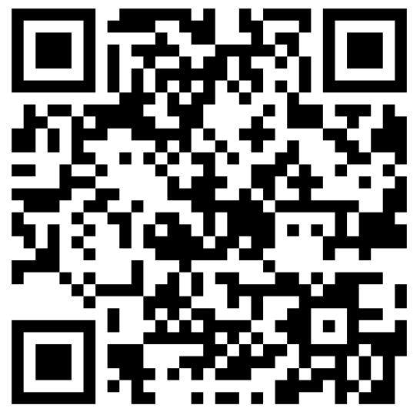
The Consultation period is now open
Closing date is 27th October 2024
Please visit https://consult.roscommoncoco.ie/en/surveys

Slide 11
Matters arising Update by Shane Tiernan
LCDC Networking Event – 09.10.24 – Athlone Springs hotel
This event was organised by the Department of Rural and Community Development to support LCDC members, encourage networking and establish best practice from an operational and project perspective.
Link to the Department’s website sent through to view the speakers presentation slides as part of the meeting request

Slide 12
LCDC Membership update by Bridie McHugh
Induction Training carried out earlier today for new members by Cathriona and Tomás.
Business Pillar – Chambers Ireland– awaiting confirmation from Chambers Ireland to provide details of nominee. As soon as nominee received, we will liaise directly with them.
Annual Report 2023 was presented to the Full Council on Monday 21st October, 2024.

Slide 13
SICAP–Update Update by Cathriona MacCarthy/member
Annual Internal Audit of SICAP
External Audit 25th and 26th November, 2024.

Slide 14
Healthy Ireland –Update Update by Aisling Dunne
Budget Update
No confirmation as yet on additional funding from 2025 budget, it is anticipated that there will be an additional €35,000 allocated to reach the €75,000 per annum target funding.
Budget underspend for Year 2 is currently €15,627.22, a number of initiatives have been identified and will be presented to Health and Wellbeing Subgroup for approval in November to utilise this funding.

Slide 15
Healthy Ireland –Update Update by Aisling Dunne
Healthy Roscommon Plan Consultation Feedback Summary
Very Good Engagement overall with 140 responses from public in addition to community group and Sub Group consultation.
Poor engagement from Non Irish Community despite support offered to facilitate this engagement.
Broad range of ages represented in feedback with biggest engagement from those aged 35 – 64.
In person, teams and Microsoft Forms utilised to complete consultation process which comprised of 16 questions relating to Health & Wellbeing issues and priorities for people living and working in Roscommon.

Slide 16
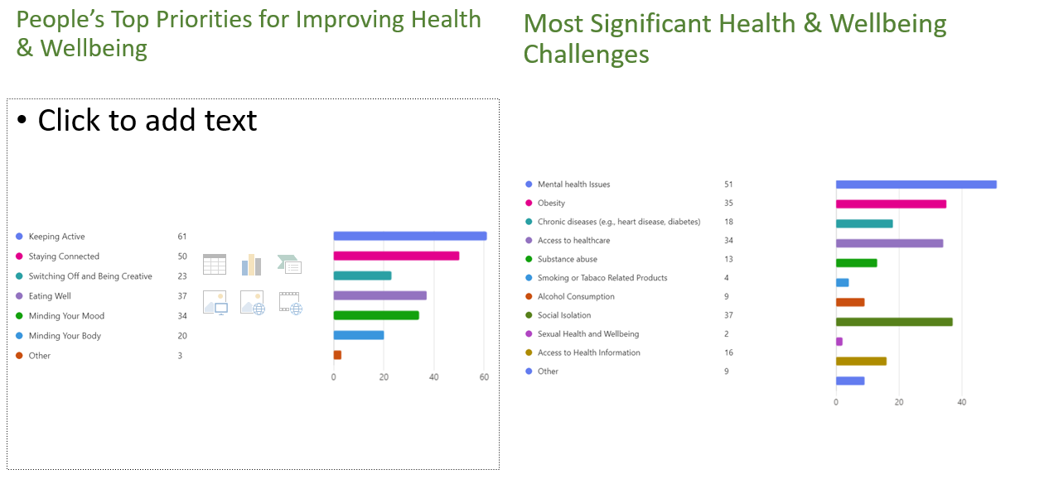
Headline feedback for incorporation
No confirmation as yet on additional funding from 2025 budget, it is anticipated that there will be an additional €35,000 allocated to reach the €75,000 per annum target funding.
Budget underspend for Year 2 is currently €15,627.22, a number of initiatives have been identified and will be presented to Health and Wellbeing Subgroup for approval in November to utilise this funding.

Slide 17
Headline feedback for incorporation

Slide 18
Funding Updates by Cathriona MacCarthy/Janice O’Brien
Local Enhancement Programme (LEP) 2024
115 Projects Approved (inc 10 Womens Groups) €138,641
69 Projects paid with 46 in progress.
Empowering Communities Programme
Recruitment for the two positions under this programme is now complete.
The Coordinator post has been filled however the position of support work had to be re-advertised this week.
Roscommon Leader Partnership are proceeding with the programme until all posts are filled.
2024 Dormant Account Fund - Action 6.3 National LGBTI+ Inclusion Strategy
Three applications submitted to the Department
Total funding sought €29,600.70

Slide 19
Funding Updates by Bridie McHugh
For noting:
Embracing Ireland’s Outdoors – Minister Humphreys announces over €1 million investment in 517 walking trails.
Roscommon - €65,167
Roscommon | Ballintubber Tidy Towns | €1500
Roscommon | Enterprise Kiltullagh | €4000
Roscommon | Cloonfad Scenic Walks | €4000
Roscommon | Granlahan Tidy Towns committee | €4000
Roscommon | Shannon Bridge Action Group | €4000
Roscommon | Suck Valley Way Committee | €25,000
Roscommon/Sligo | Lung Lough Gara Way Committee | €15000

Slide 20
Clár funded projects as per announcement on 07.10.24
Roscommon | Reeside Athletics Club | €50,000
Roscommon | Enterprise Castlerea Ltd | €49,296
Roscommon | Moore United | €50,000
Roscommon | St Aidans GAA | €50,000
Roscommon | Ballintubber Development Association | €50,000
Roscommon | Gorthaganny (marian Hall) Community Centre | €50,000
Roscommon | Clann na Geal GAA | €49,217
Roscommon | Elphin Community Centre | €50,000
Roscommon | Strokestown | €49,050
Roscommon | Tulsk GAA | €43,195
Roscommon | Boyle Town Teams | €39,649
Roscommon | Keadue Sportsfield Committe | €45,000
Roscommon | St. Mary’s Hall, Kilbegnet & Glinsk | €33,268
Roscommon | St. Roman’s Hall | €42,082
Roscommon | Ballyleague National School | €50,000

Slide 21
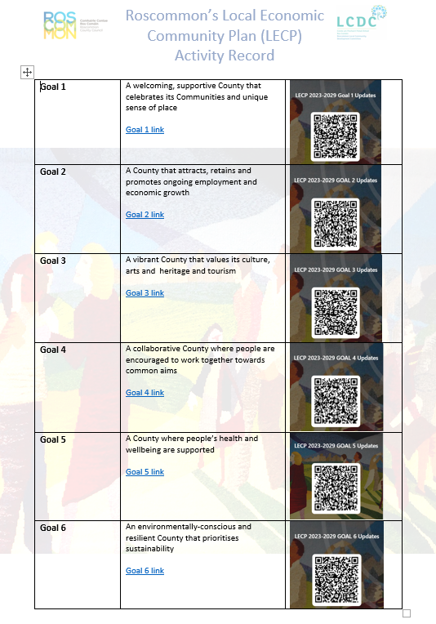
LECP 2023-2029 Monitoring Bridie McHugh
LCDC is responsible for on-going monitoring of community elements of the LECP.
LECP Activity record created to allow the goals a link and QR code to be accessed and allow goals to be updated.

Slide 22
Monitoring of Goal 5 ‘A county where people’s health and wellbeing are supported’ SCO 5.1 Support a positive approach to health and well-being for everyone living, working and visiting County Roscommon. SCO 5.2 Continue to support and promote community safety.
Monitoring of Goal 6
‘An environmentally conscious and resilient county that prioritises sustainability’
SCO 6.1 Promote and ensure environmental protection and enhancement of the natural and built environment.
SCO 6.2 Encourage and facilitate community and business participation in the reduction of County Roscommon’s carbon footprint.

Slide 23
Contact details for assistance
Cathriona MacCarthy cathriona.maccarthy@roscommoncoco.ie
Bridie McHugh bmchugh@roscommoncoco.ie
Janice O’Brien jobrien@roscommoncoco.ie

Slide 24
Any Other Business

Slide 25
Next meeting of Roscommon LCDC
11th December 2024 @3pm
Via MS Teams

