Slide 1
Too Loud, Too Bright and the seams on my socks hurt – Understanding, Including and Affirming those with sensory processing challenges.
Dr Dorothy Armstrong MSc PhD
Occupational Therapist
Achieve Occupational Therapy, Kildare
Email: officeachieveot@gmail.com
www.achieveot.net
Contact for copy of slides
https://sligolibrary.ie/sense-ability/

Slide 2
Common Experiences
I can’t go in there to eat as it smells wrong
I can’t wear that it hurts me
I can’t wear that it feels all wrong
That colour/pattern makes me feel sick
It’s too loud I can’t think
It’s too loud it hurts and I can’t cope
Please let me move it makes me feel comfortable
People are moving unpredictably and it hurts my head
Its too bright in here

Slide 3
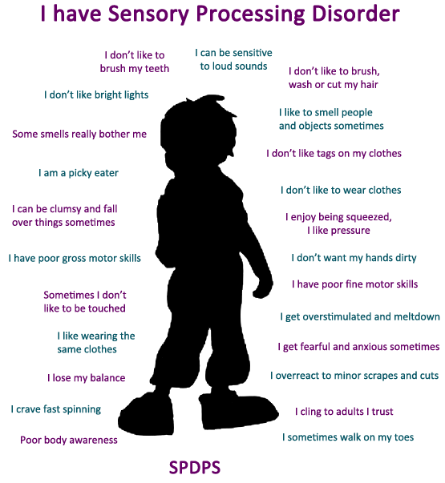

Slide 4
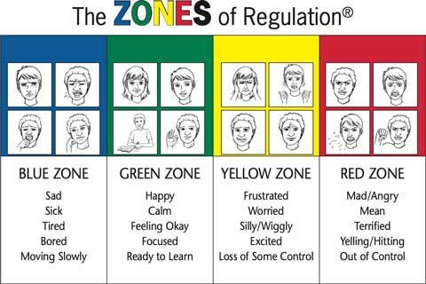
2011 Think Social Publishing, Inc. All rights reserved. From The Zones of Regulation™ by Leah M. Kuypers • Available at www.socialthinking.com

Slide 5
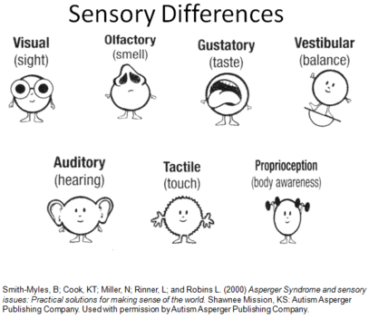
Think about what should go in your sensory kit

Slide 6
How would you feel?

Slide 7
What do you do?
You’re sitting for a really long time listening to a very boring person talking in a monotone with low lights in a really warm room.

Slide 8
The Different Sensory Issues
Sensory Registration:
This is the degree to which the person misses some forms of sensory input.
Sensory Seeking:
The degree to which a person seeks sensory input. People who are under-responsive to certain types of sensory information tend to ‘crave it’.
Sensory Sensitivity:
This is the degree to which a person notices and is bothered by some forms of sensory input.
Sensory Avoiding:
This is the degree to which the person attempts to avoid sensory input. People will tend to avoid sensation they are sensitive to

Slide 9
Tactile System - Touch
For tactile defensive people light touch is irritating and heavy touch is calming
Deep touch/pressure, Calms and organizes and can helps the person learn and think
Respect the person’s clothing preferences as far as possible
The person may benefit from a Fidget ‘toy’
Cut tags off clothes if they are annoying and wash clothes in familiar detergent

Slide 10
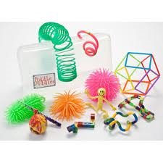
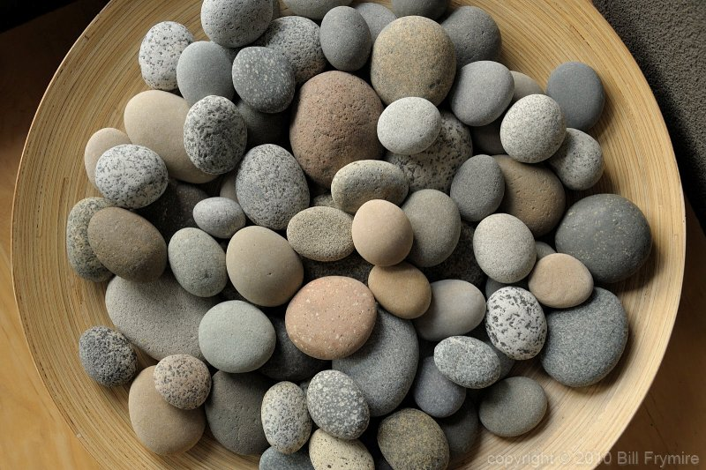
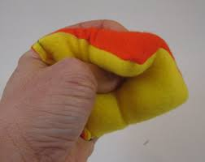
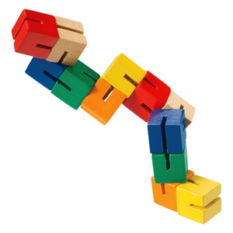
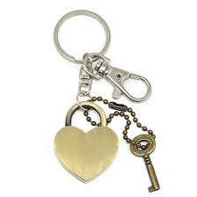
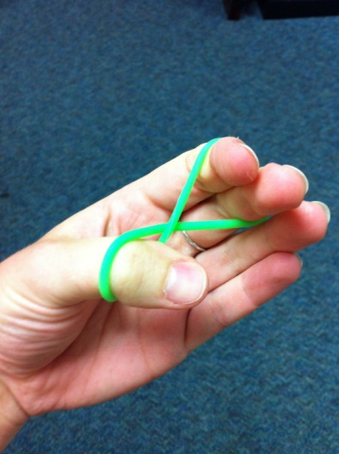
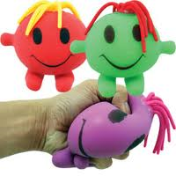
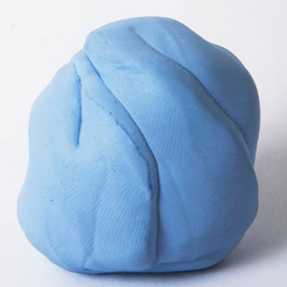

Slide 11
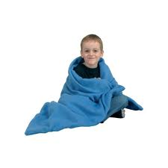
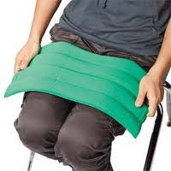
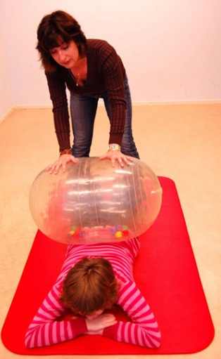
Deep Pressure for the tactile system is calming
Have a bean bag to sink into with a weighted blanket or toy over the person

Slide 12
Do Not:
Push a person beyond what they are comfortable with it can cause over-activity, distress and in extreme situations shut down.

Slide 13
Proprioception – Heavy input to the joints and muscles
This is the essential ‘go to’ tool for calming and helping the person regulate
“Heavy work” activities - The larger the joint, the more proprioceptive input
For toe walking try heavy boots

Slide 14
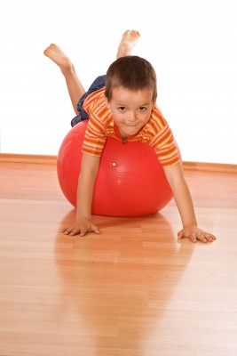
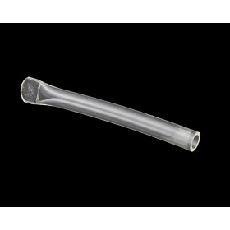
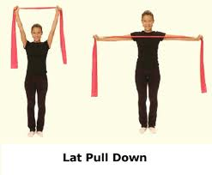
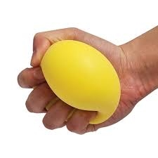
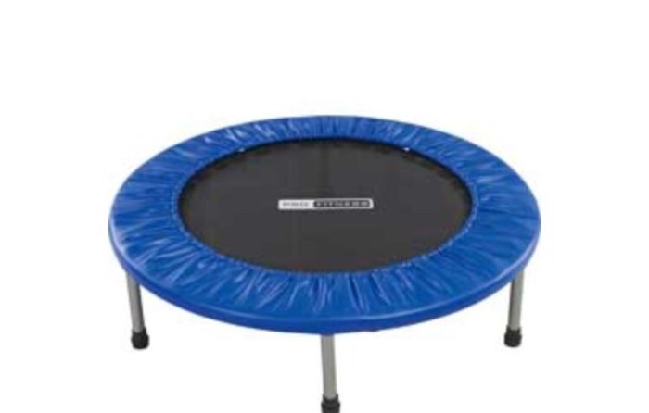
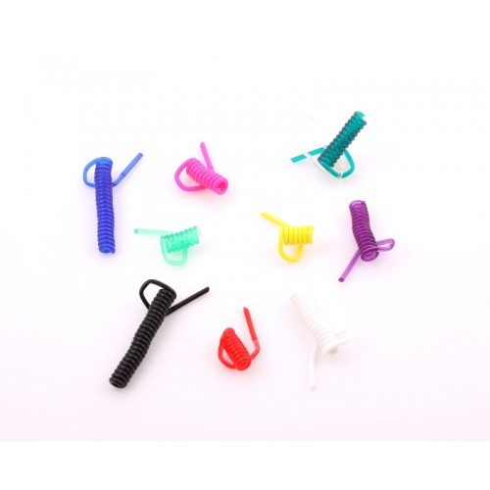
Proprioceptive Input

Slide 15
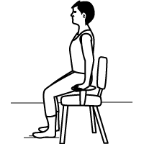
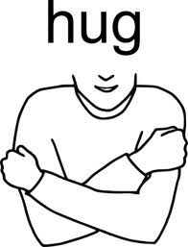
Quick Proprioceptive movement breaks:

Slide 16
Vestibular System
The vestibular system refers to structures within the inner ear (the semi-circular canals)
These structures detect movement and changes in the position of the head.
Movement can change an individual’s attention, and alertness in the shortest period of time

Slide 17
If Hyper-sensitive
Fearful reactions to ordinary movement activities
Apprehensive walking or crawling on uneven or unstable surfaces
Appear clumsy
Want their feet on the ground!

Slide 18
Our movement seekers – vestibular and proprioceptive
Seeker: Actively seek and demonstrate a need for intense movement experiences (whirling, jumping, spinning, spinning objects, pacing)
Bumping and crashing – proprioceptive seeker.
However they can become over-excited if spinning too much so
Needs monitoring
“Cap-off” vigorous vestibular activity with proprioception (“heavy work” or compression)

Slide 19
Activities that can help
Seeker/Avoider/Overwhelmed
Linear, Calm, Slow, Controlled movement
Sensory seeker:
Movement Breaks
Tools for home – peanut rolls, trampettes, exercise bikes, wobble cushion for the table, fidgets

Slide 20
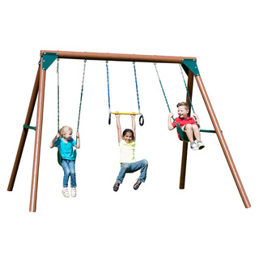
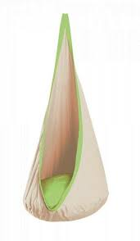
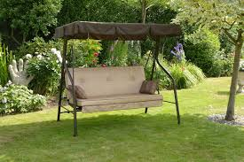
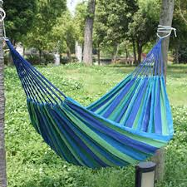

Slide 21
Auditory
The person may hear background sound that you can ‘tune out’ and be bothered by it e.g. hum of a light or a noisy radiator.
Rooms with an echo like a gym hall can be very difficult
Whenever possible, people with SPD should be forewarned about bells, announcements, fire drills etc.
Concerts, church services, theatres or cinemas
Reduce background noise e.g. play calming music such as Mozart in the headphones.
Chewing will also help.
Check that the person has processed what you have said

Slide 22
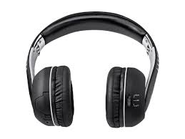
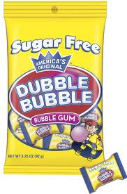
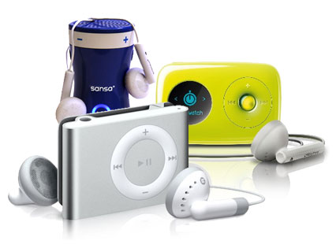
What can help?

Slide 23
Vision
Glare can be very difficult – e.g. the glare on a white board
Lights can feel too bright
Shopping malls too white and too bright
Contrasting colours so specific patterns may cause nausea
May require Irlen filters for reading etc.
May need transition lenses or cap with visor on sunny days (or even indoors if light is distressing).
Visually calming tools can be helpful

Slide 24
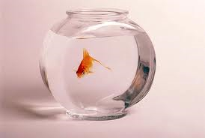
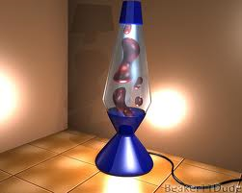
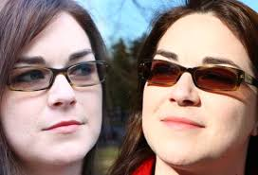
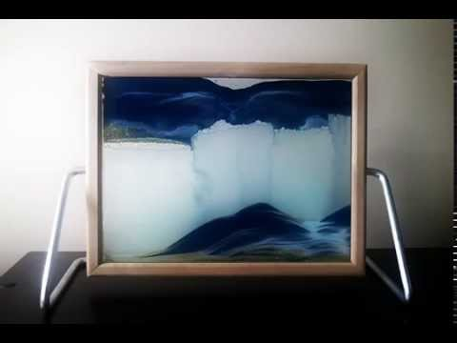
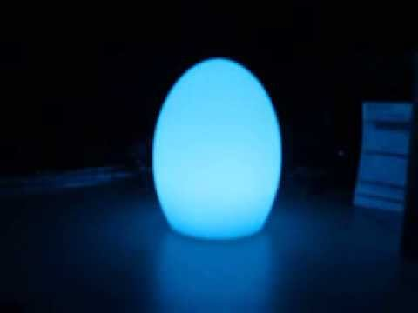
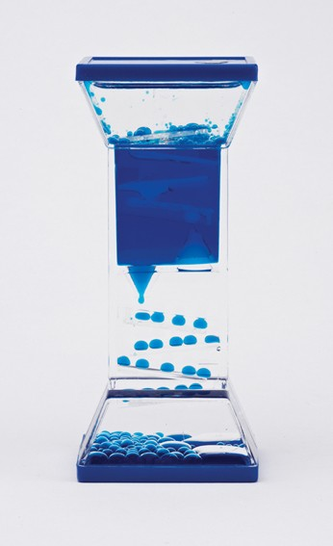
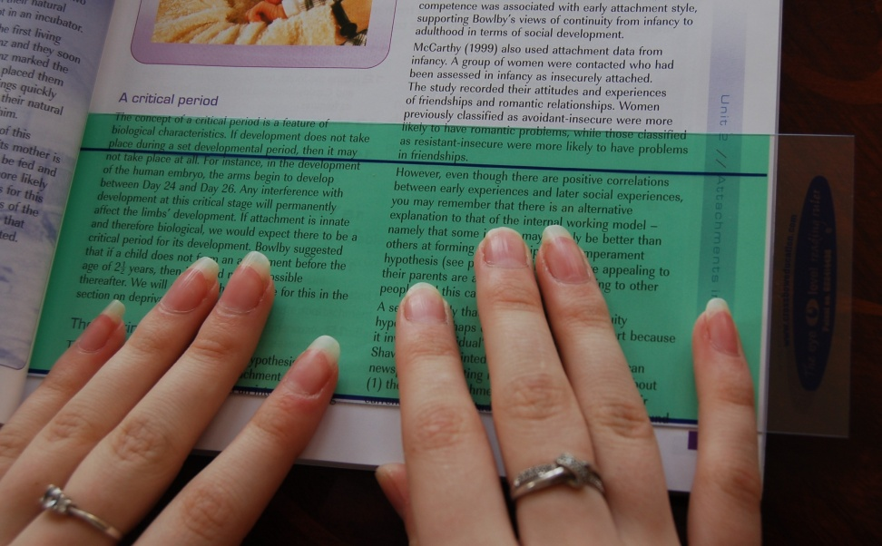
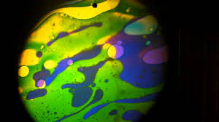

Slide 25
Mouth
Alerting
Crunching dry cereal, chips, crackers, popcorn, nuts, carrots, pretzels, celery, apples and sour sweets. Eating sour or spicy foods.
ORGANIZING – getting just right
Chewing granola or fruit bars, dried fruit, gums, bagels – resistive, chew tubes, “chewelry”, Blow Toys, bubbles.
CALMING
Eat, suck, chew thick liquids or soft substances , sucking hard sweets.
Water bottles/sport bottles –have to be the variety that requires child to suck

Slide 26
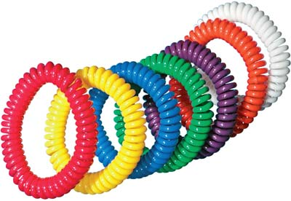
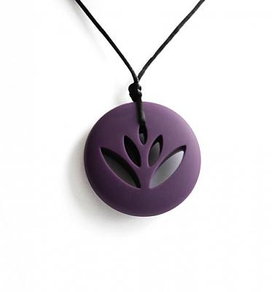
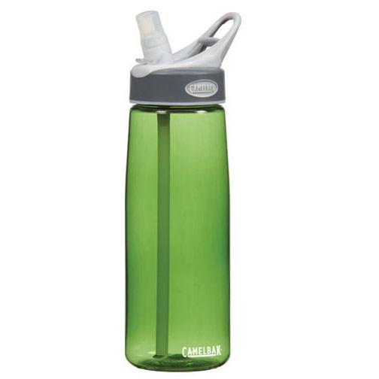

Slide 27
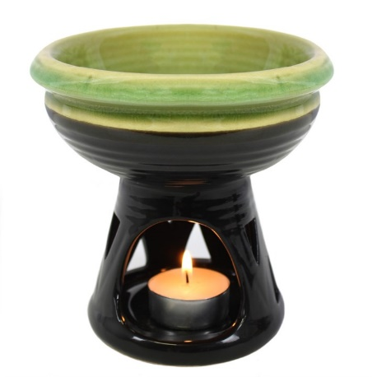
Smells – Be Careful
Respect the person’s preferences as far as possible
Try burning different essential oils in a burner to see what works for the person
Can help to have a smell to block other smells out

Slide 28
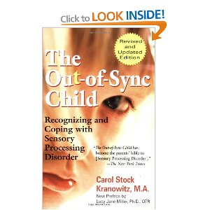
Good Books

Slide 29
Finally
Let’s advocate for sensory sensitive spaces whenever we can
Dr Dorothy Armstrong MSc PhD
Occupational Therapist
Contact for copy of slides
https://sligolibrary.ie/sense-ability/
Achieve Occupational Therapy, Private Practice, Celbridge
Email: officeachieveot@gmail.com
www.achieveot.net

